Slide 1
Multilayer Feedforward Network
By
Varun Deshmukh
Assistant Professor,
Department of Computer Engineering,
MPSTME, Shirpur Campus

Slide 2
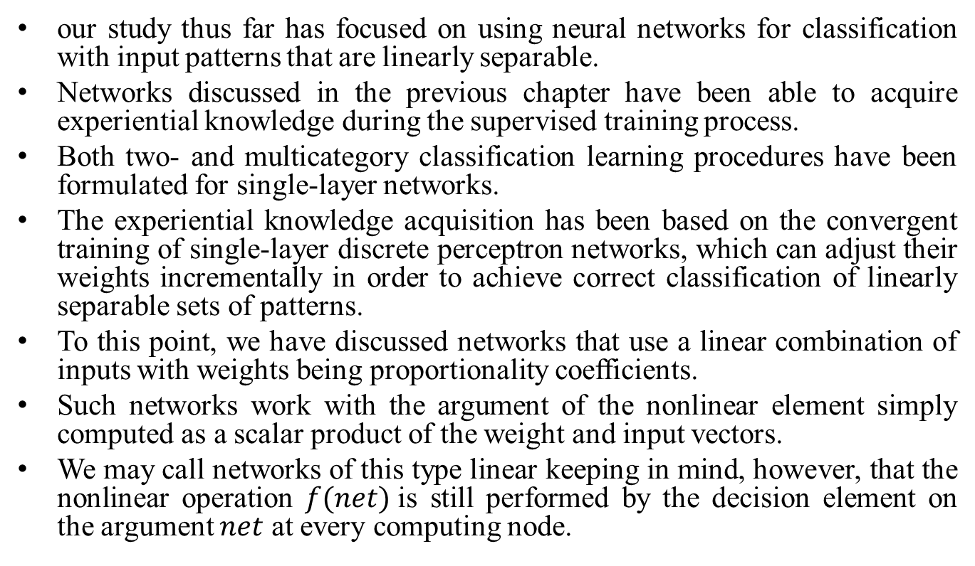
Introduction
our study thus far has focused on using neural networks for classification with input patterns that are linearly separable.
Networks discussed in the previous chapter have been able to acquire experiential knowledge during the supervised training process.
Both two- and multicategory classification learning procedures have been formulated for single-layer networks.
The experiential knowledge acquisition has been based on the convergent training of single-layer discrete perceptron networks, which can adjust their weights incrementally in order to achieve correct classification of linearly separable sets of patterns.
To this point, we have discussed networks that use a linear combination of inputs with weights being proportionality coefficients.
Such networks work with the argument of the nonlinear element simply computed as a scalar product of the weight and input vectors.
We may call networks of this type linear keeping in mind, however, that the nonlinear operation $f(net)$is still performed by the decision element on the argument $net$ at every computing node.

Slide 3
Introduction
For training patterns that are linearly separable, the linear neural network introduced in previous chapters must be modified if it is to perform the correct classification.
The modification could involve either a departure from the concept of the linear discriminant function or a major change in network architecture.
Typical nonlinear discriminant functions are chosen to be quadratic or piecewise linear.
The piecewise linear discriminant functions can be implemented by a single-layer :linear network employing perceptron's (Nilsson 1965).
Our chosen architecture,: however, will be that of the multilayer network.
Each layer of a multilayer network is composed of a linear network, i.e., it is based on the original concept of the linear discriminant function.
Although multilayer learning machines have been known of for more than a quarter of a century, the lack of appropriate training algorithms has prevented their successful applications for practical tasks.

Slide 4
Introduction
Recent developments in the supervised training algorithms of multilayer networks with each layer employing the linear discriminant function have led to their widespread and successful present use.
Multilayer networks are often called layered networks. They can implement arbitrary complex input/output mappings or decision surfaces separating pattern classes.
The most important attribute of a multilayer feedforward network is that it can learn a mapping of any complexity.
The network learning is based on repeated presentations of the training samples, as has been the case for single-layer networks.
The trained network often produces surprising results and generalizations in applications where explicit derivation of mappings and discovery of relationships is almost impossible.
In addition to the classification tasks studied to gain insight into the single- and multilayer neural networks, many other tasks can be performed by such networks.

Slide 5
Introduction
Examples include function approximation, handwritten character recognition, speech recognition, dynamical plant control, robot kinematics and trajectory generation, expert systems, and many other applications.
Multilayer feedforward network theory and applications have been dominating in the neural network literature for several years now.
Researchers have looked for the properties of layered networks and their training methods.
Industrial entrepreneurs found a wealth of successful applications, others developed accelerator boards to speed up network simulations on personal computers, and graduate students began to write and sell inexpensive training software.
Layered networks seem to be the most widespread neural network architecture at present.
To understand the nature of mapping performed by multilayer feedforward networks and the training of such networks, we must return to the fundamentals.

Slide 6
Adaptive Linear Neuron (Adaline)
Theory:
The units with linear activation function are called linear units. A network with a single linear unit is called an Adaline (adaptive linear neuron).
That is, in an Adaline, the input-output relationship is linear.
Adaline uses bipolar activation for its input signals and its target output.
The weights between the input and the output are adjustable.
The bias in Adaline acts like an adjustable weight, whose connection is from a unit with activations being always 1.
Adaline is a net which has only one output unit. The Adaline network may be trained using delta rule.
The delta rule may also be called as least mean square (LMS) rule or Widrow Hoff rule.
This learning rule is found to minimize the mean squared error between the activation and the target value.

Slide 7
Adaptive Linear Neuron (Adaline)
Delta Rule for Single Output Unit:
The Widrow-Hoff rule is very similar to perceptron learning rule. However, their origins are different.
The perceptron learning rule originates from the Hebbian assumption while the delta rule is derived from the gradient descent method (it can be generalized to more than one layer).
Also, the perceptron learning rule stops after a finite number of learning steps, but the gradient descent approach continues forever, converging only asymptotically to the solution.
The delta rule updates the weights between the connections so as to minimize the difference between the net input to the output unit and the target value.
The major aim is to minimize the error over all training patterns. This is done by reducing the error for each pattern, one at a time.

Slide 8
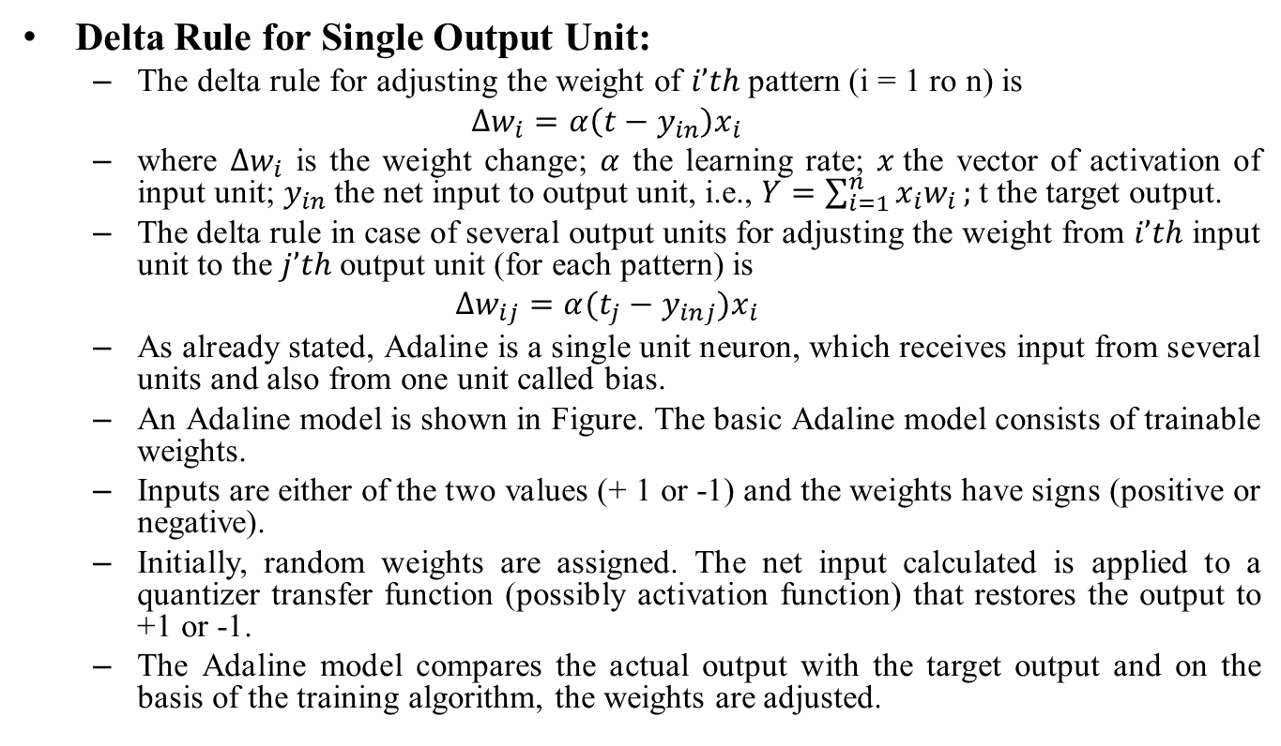
Adaptive Linear Neuron (Adaline)
Delta Rule for Single Output Unit:
The delta rule for adjusting the weight of $i’th$ pattern (i = 1 ro n) is
$$∆w_{i}=α\left(t−y_{in}\right)x_{i}$$
where $∆w_{i}$ is the weight change; $α$ the learning rate; $x$the vector of activation of input unit; $y_{in}$the net input to output unit, i.e., $Y=\sum_{i=1}^{n}{x_{i}w_{i}};$t the target output.
The delta rule in case of several output units for adjusting the weight from $i’th$ input unit to the $j’th$ output unit (for each pattern) is
$$∆w_{ij}=α(t_{j}−y_{inj})x_{i}$$
As already stated, Adaline is a single unit neuron, which receives input from several units and also from one unit called bias.
An Adaline model is shown in Figure. The basic Adaline model consists of trainable weights.
Inputs are either of the two values (+ 1 or -1) and the weights have signs (positive or negative).
Initially, random weights are assigned. The net input calculated is applied to a quantizer transfer function (possibly activation function) that restores the output to +1 or -1.
The Adaline model compares the actual output with the target output and on the basis of the training algorithm, the weights are adjusted.

Slide 9
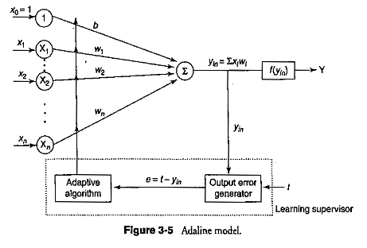
Adaptive Linear Neuron (Adaline)

Slide 10
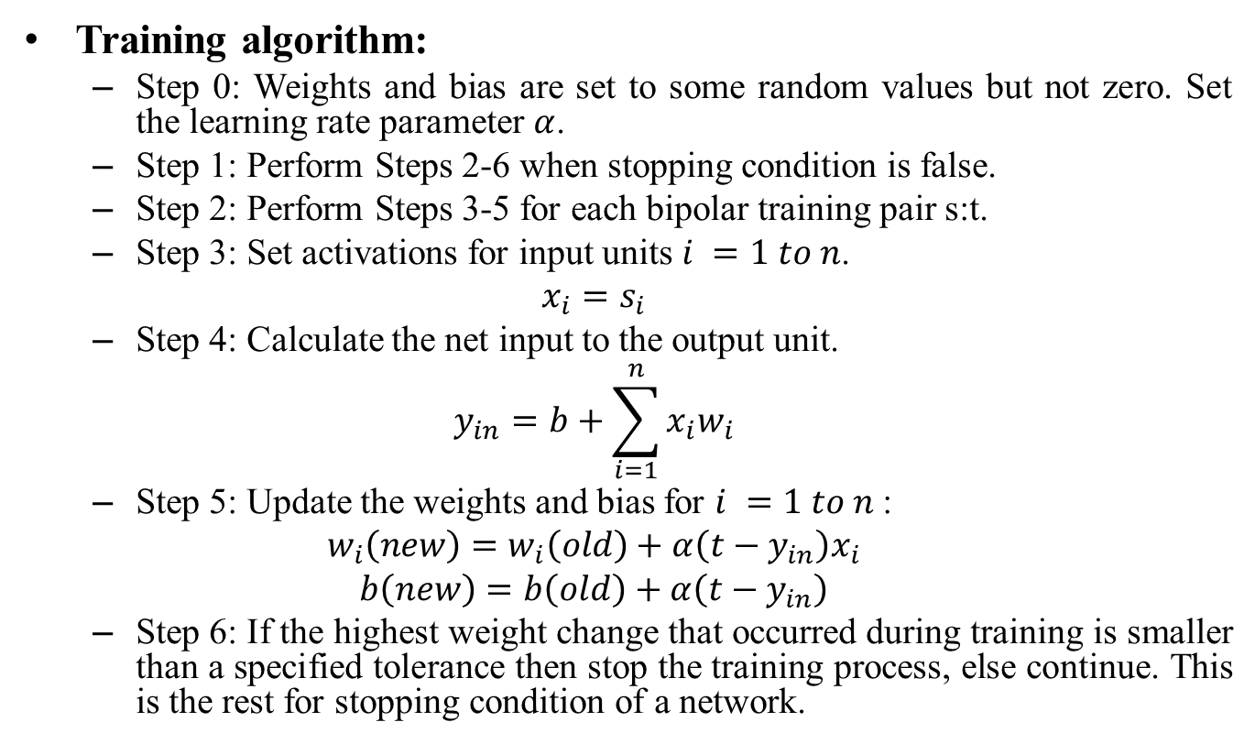
Adaptive Linear Neuron (Adaline)
Training algorithm:
Step 0: Weights and bias are set to some random values but not zero. Set the learning rate parameter $α$.
Step 1: Perform Steps 2-6 when stopping condition is false.
Step 2: Perform Steps 3-5 for each bipolar training pair s:t.
Step 3: Set activations for input units $i =1 to n$.
$$x_{i}=s_{i}$$
Step 4: Calculate the net input to the output unit.
$$y_{in}=b+\sum_{i=1}^{n}{x_{i}w_{i}}$$
Step 5: Update the weights and bias for $i =1 to n$:
$$w_{i}\left(new\right)=w_{i}\left(old\right)+α\left(t−y_{in}\right)x_{i}$$
$$b\left(new\right)=b\left(old\right)+α\left(t−y_{in}\right)$$
Step 6: If the highest weight change that occurred during training is smaller than a specified tolerance then stop the training process, else continue. This is the rest for stopping condition of a network.

Slide 11
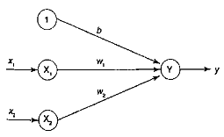
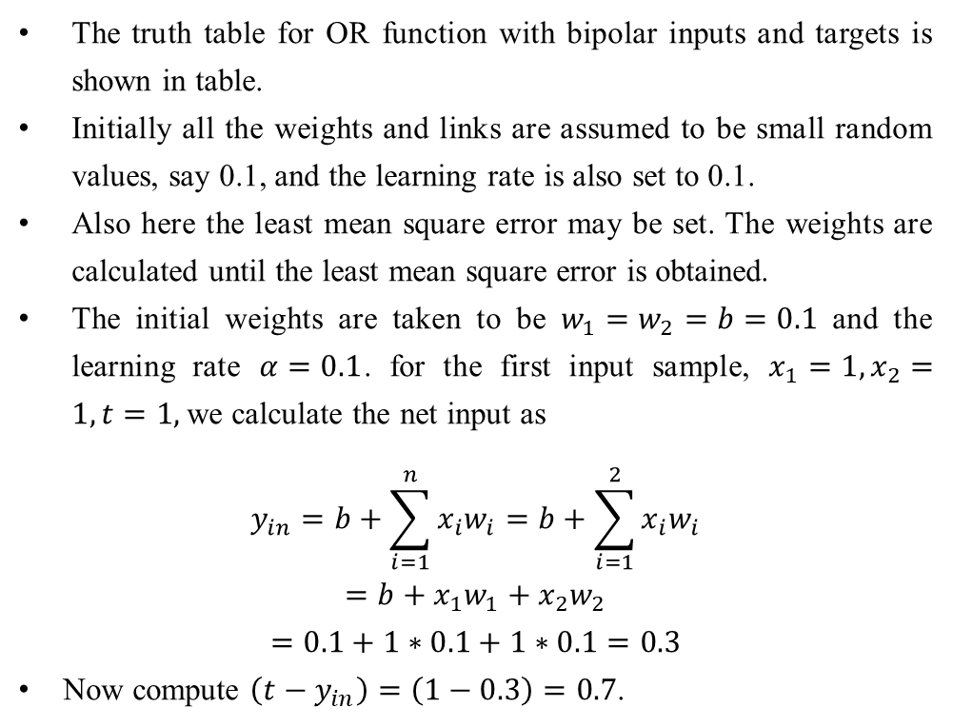
Examples
Implement OR function with bipolar inputs and targets using Adaline Network.
Solution:
The truth table for OR function with bipolar inputs and targets is shown in table.
Initially all the weights and links are assumed to be small random values, say 0.1, and the learning rate is also set to 0.1.
Also here the least mean square error may be set. The weights are calculated until the least mean square error is obtained.
The initial weights are taken to be $w_{1}=w_{2}=b=0.1$ and the learning rate $α=0.1$. for the first input sample, $x_{1}=1, x_{2}=1, t=1,$we calculate the net input as
$$y_{in}=b+\sum_{i=1}^{n}{x_{i}w_{i}}=b+\sum_{i=1}^{2}{x_{i}w_{i}}$$
$$=b+x_{1}w_{1}+x_{2}w_{2}$$
$$=0.1+1∗0.1+1∗0.1=0.3$$
Now compute $\left(t−y_{in}\right)=\left(1−0.3\right)=0.7$.
x1 | x2 | t
1 | 1 | 1
1 | -1 | 1
-1 | 1 | 1
-1 | -1 | -1

Slide 12
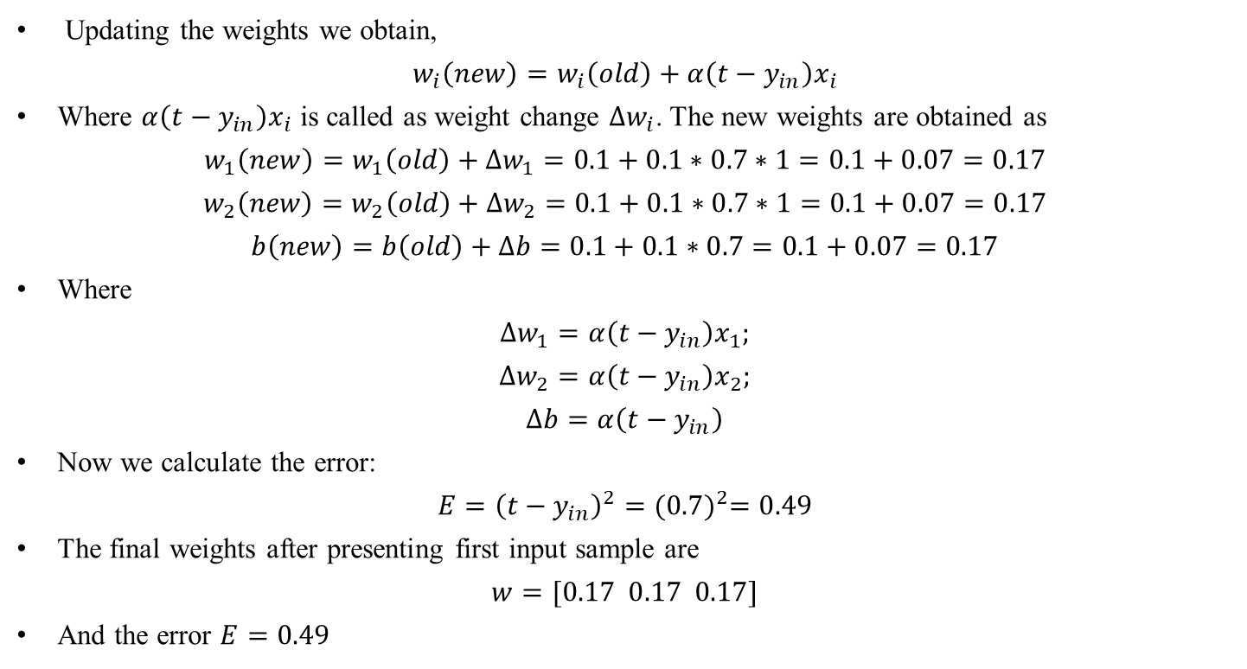
Examples
Updating the weights we obtain,
$$w_{i}\left(new\right)=w_{i}\left(old\right)+α\left(t−y_{in}\right)x_{i}$$
Where $α\left(t−y_{in}\right)x_{i}$ is called as weight change $∆w_{i}$. The new weights are obtained as
$$w_{1}\left(new\right)=w_{1}\left(old\right)+∆w_{1}=0.1+0.1∗0.7∗1=0.1+0.07=0.17$$
$$w_{2}\left(new\right)=w_{2}\left(old\right)+∆w_{2}=0.1+0.1∗0.7∗1=0.1+0.07=0.17$$
$$b\left(new\right)=b\left(old\right)+∆b=0.1+0.1∗0.7=0.1+0.07=0.17$$
Where
$$∆w_{1}=α\left(t−y_{in}\right)x_{1};$$
$$∆w_{2}=α\left(t−y_{in}\right)x_{2};$$
$$∆b=α\left(t−y_{in}\right)$$
Now we calculate the error:
$$E={\left(t−y_{in}\right)}^{2}={(0.7)}^{2}=0.49$$
The final weights after presenting first input sample are
$$w=[0.17 0.17 0.17]$$
And the error $E=0.49$

Slide 13
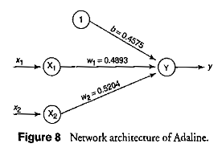
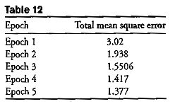
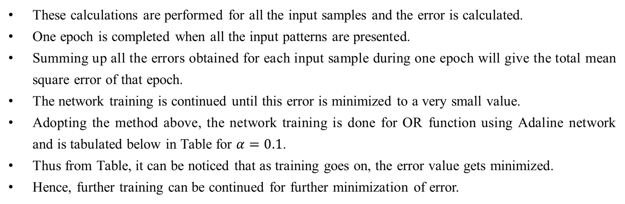
Examples
These calculations are performed for all the input samples and the error is calculated.
One epoch is completed when all the input patterns are presented.
Summing up all the errors obtained for each input sample during one epoch will give the total mean square error of that epoch.
The network training is continued until this error is minimized to a very small value.
Adopting the method above, the network training is done for OR function using Adaline network and is tabulated below in Table for $α=0.1$.
Thus from Table, it can be noticed that as training goes on, the error value gets minimized.
Hence, further training can be continued for further minimization of error.

Slide 14
x1 | x2 | 1 | t | yin | t-yin | dw1 | dw2 | db | w1 | w2 | b | error
 |  |  |  |  |  |  |  |  | 0.1 | 0.1 | 0.1
1 | 1 | 1 | 1 | 0.3 | 0.7 | 0.07 | 0.07 | 0.07 | 0.17 | 0.17 | 0.17 | 0.49
1 | -1 | 1 | 1 | 0.17 | 0.83 | 0.083 | -0.083 | 0.083 | 0.253 | 0.087 | 0.253 | 0.6889
-1 | 1 | 1 | 1 | 0.087 | 0.913 | -0.0913 | 0.0913 | 0.0913 | 0.1617 | 0.1783 | 0.3443 | 0.8336
-1 | -1 | 1 | -1 | 0.0043 | -1.0043 | 0.1004 | 0.1004 | -0.1004 | 0.2621 | 0.2787 | 0.2439 | 1.0086
1 | 1 | 1 | 1 | 0.7847 | 0.2153 | 0.0215 | 0.0215 | 0.0215 | 0.2836 | 0.3002 | 0.2654 | 0.0464
1 | -1 | 1 | 1 | 0.2488 | 0.7512 | 0.0751 | -0.0751 | 0.0751 | 0.3587 | 0.2251 | 0.3405 | 0.5643
-1 | 1 | 1 | 1 | 0.2069 | 0.7931 | -0.0793 | 0.0793 | 0.0793 | 0.2794 | 0.3044 | 0.4198 | 0.629
-1 | -1 | 1 | -1 | -0.164 | -0.836 | 0.0836 | 0.0836 | -0.0836 | 0.363 | 0.388 | 0.3362 | 0.6989
1 | 1 | 1 | 1 | 1.0872 | -0.0872 | -0.0087 | -0.0087 | -0.0087 | 0.3543 | 0.3793 | 0.3275 | 0.0076
1 | -1 | 1 | 1 | 0.3025 | 0.6975 | 0.0698 | -0.0698 | 0.0698 | 0.4241 | 0.3095 | 0.3973 | 0.4865
-1 | 1 | 1 | 1 | 0.2827 | 0.7173 | -0.0717 | 0.0717 | 0.0717 | 0.3524 | 0.3812 | 0.469 | 0.5145
-1 | -1 | 1 | -1 | -0.2646 | -0.7354 | 0.0735 | 0.0735 | -0.0735 | 0.4259 | 0.4547 | 0.3955 | 0.5408
1 | 1 | 1 | 1 | 1.2761 | -0.2761 | -0.0276 | -0.0276 | -0.0276 | 0.3983 | 0.4271 | 0.3679 | 0.0762
1 | -1 | 1 | 1 | 0.3391 | 0.6609 | 0.0661 | -0.0661 | 0.0661 | 0.4644 | 0.361 | 0.434 | 0.4368
-1 | 1 | 1 | 1 | 0.3306 | 0.6694 | -0.0669 | 0.0669 | 0.0669 | 0.3975 | 0.4279 | 0.5009 | 0.4481
-1 | -1 | 1 | -1 | -0.3245 | -0.6755 | 0.0676 | 0.0676 | -0.0676 | 0.4651 | 0.4955 | 0.4333 | 0.4563
1 | 1 | 1 | 1 | 1.3939 | -0.3939 | -0.0394 | -0.0394 | -0.0394 | 0.4257 | 0.4561 | 0.3939 | 0.1552
1 | -1 | 1 | 1 | 0.3635 | 0.6365 | 0.0637 | -0.0637 | 0.0637 | 0.4894 | 0.3924 | 0.4576 | 0.4051
-1 | 1 | 1 | 1 | 0.3606 | 0.6394 | -0.0639 | 0.0639 | 0.0639 | 0.4255 | 0.4563 | 0.5215 | 0.4088
-1 | -1 | 1 | -1 | -0.3603 | -0.6397 | 0.064 | 0.064 | -0.064 | 0.4895 | 0.5203 | 0.4575 | 0.4092

Slide 15
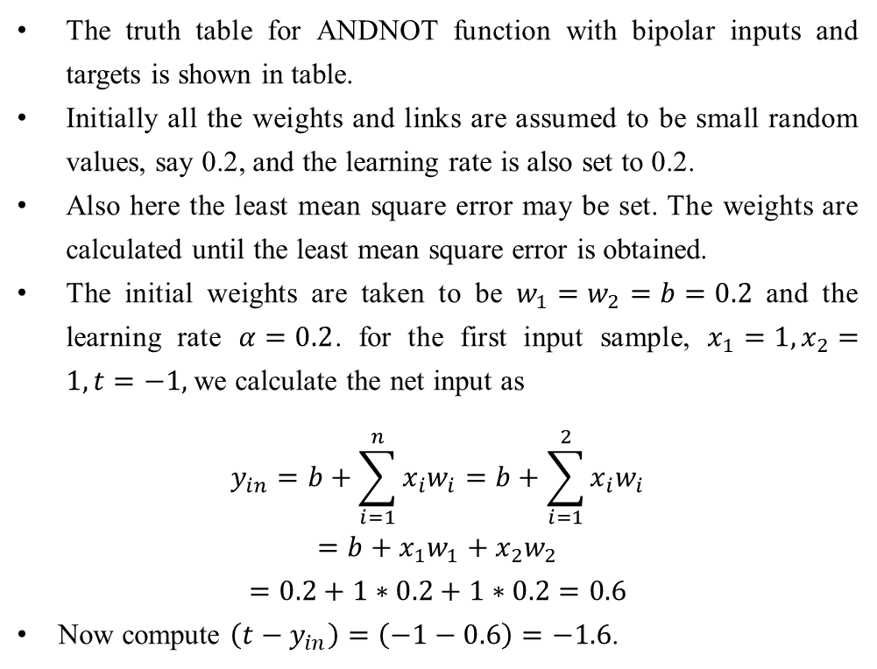
Examples
Use Adaline Network to train ANDNOT function with bipolar inputs and targets. Perform 2 epochs of training.
Solution:
The truth table for ANDNOT function with bipolar inputs and targets is shown in table.
Initially all the weights and links are assumed to be small random values, say 0.2, and the learning rate is also set to 0.2.
Also here the least mean square error may be set. The weights are calculated until the least mean square error is obtained.
The initial weights are taken to be $w_{1}=w_{2}=b=0.2$ and the learning rate $α=0.2$. for the first input sample, $x_{1}=1, x_{2}=1, t=−1,$we calculate the net input as
$$y_{in}=b+\sum_{i=1}^{n}{x_{i}w_{i}}=b+\sum_{i=1}^{2}{x_{i}w_{i}}$$
$$=b+x_{1}w_{1}+x_{2}w_{2}$$
$$=0.2+1∗0.2+1∗0.2=0.6$$
Now compute $\left(t−y_{in}\right)=\left(−1−0.6\right)=−1.6$.
x1 | x2 | t
1 | 1 | -1
1 | -1 | 1
-1 | 1 | -1
-1 | -1 | -1

Slide 16
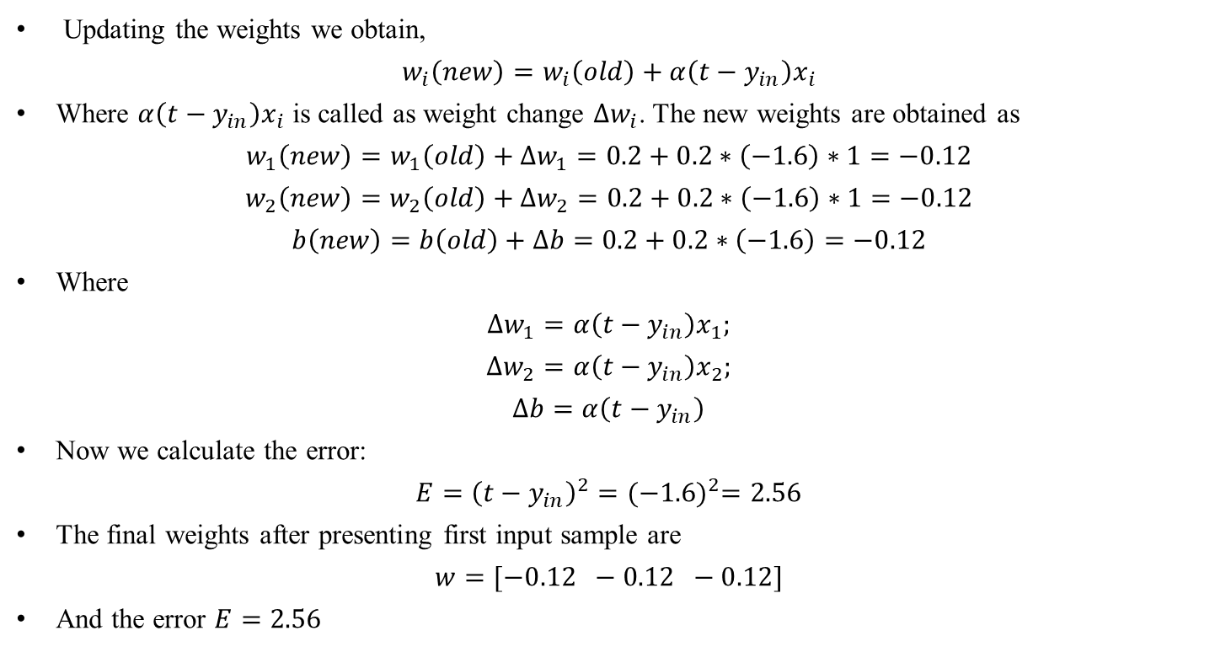
Examples
Updating the weights we obtain,
$$w_{i}\left(new\right)=w_{i}\left(old\right)+α\left(t−y_{in}\right)x_{i}$$
Where $α\left(t−y_{in}\right)x_{i}$ is called as weight change $∆w_{i}$. The new weights are obtained as
$$w_{1}\left(new\right)=w_{1}\left(old\right)+∆w_{1}=0.2+0.2∗\left(−1.6\right)∗1=−0.12$$
$$w_{2}\left(new\right)=w_{2}\left(old\right)+∆w_{2}=0.2+0.2∗\left(−1.6\right)∗1=−0.12$$
$$b\left(new\right)=b\left(old\right)+∆b=0.2+0.2∗\left(−1.6\right)=−0.12$$
Where
$$∆w_{1}=α\left(t−y_{in}\right)x_{1};$$
$$∆w_{2}=α\left(t−y_{in}\right)x_{2};$$
$$∆b=α\left(t−y_{in}\right)$$
Now we calculate the error:
$$E={\left(t−y_{in}\right)}^{2}={(−1.6)}^{2}=2.56$$
The final weights after presenting first input sample are
$$w=[−0.12 −0.12 −0.12]$$
And the error $E=2.56$

Slide 17
x1 | x2 | 1 | t | yin | t-yin | dw1 | dw2 | db | w1 | w2 | b | error
 |  |  |  |  |  |  |  |  | 0.2 | 0.2 | 0.2
1 | 1 | 1 | -1 | 0.6 | -1.6 | -0.32 | -0.32 | -0.32 | -0.12 | -0.12 | -0.12 | 2.56
1 | -1 | 1 | 1 | -0.12 | 1.12 | 0.224 | -0.224 | 0.224 | 0.104 | -0.344 | 0.104 | 1.2544
-1 | 1 | 1 | -1 | -0.344 | -0.656 | 0.1312 | -0.1312 | -0.1312 | 0.2352 | -0.4752 | -0.0272 | 0.4303
-1 | -1 | 1 | -1 | 0.2128 | -1.2128 | 0.2426 | 0.2426 | -0.2426 | 0.4778 | -0.2326 | -0.2698 | 1.4709
1 | 1 | 1 | -1 | -0.0246 | -0.9754 | -0.1951 | -0.1951 | -0.1951 | 0.2827 | -0.4277 | -0.4649 | 0.9514
1 | -1 | 1 | 1 | 0.2455 | 0.7545 | 0.1509 | -0.1509 | 0.1509 | 0.4336 | -0.5786 | -0.314 | 0.5693
-1 | 1 | 1 | -1 | -1.3262 | 0.3262 | -0.0652 | 0.0652 | 0.0652 | 0.3684 | -0.5134 | -0.2488 | 0.1064
-1 | -1 | 1 | -1 | -0.1038 | -0.8962 | 0.1792 | 0.1792 | -0.1792 | 0.5476 | -0.3342 | -0.428 | 0.8032

Slide 18
Multiple Adaptive Linear Neuron
Theory:
The multiple adaptive linear neurons (Madaline) model consists of many Adaline's in parallel with a single output unit whose value is based on certain selection rules. It may use majority vote rule.
On using this rule, the output would have as answer either true or false.
On the other hand, if AND rule is used, the output is true if and only if both the inputs are true, and so on.
The weights that are connected from the Adaline layer to the Madaline layer are fixed, positive and possess equal values.
The weights between the input layer and the Adaline layer are adjusted during the training process.
The Adaline and Madaline layer neurons have a bias of excitation "l" connected to them.
The training process for a Madaline system is similar to that of an Adaline.

Slide 19
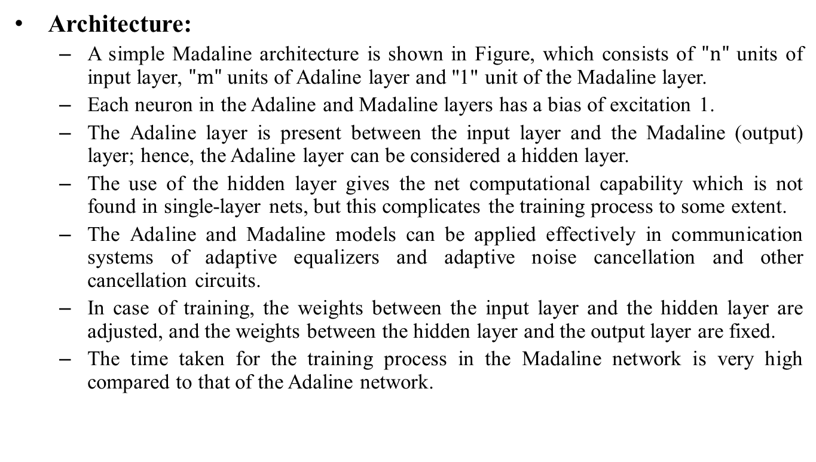
Multiple Adaptive Linear Neuron
Architecture:
A simple Madaline architecture is shown in Figure, which consists of $"n"$ units of input layer, $"m"$ units of Adaline layer and "1" unit of the Madaline layer.
Each neuron in the Adaline and Madaline layers has a bias of excitation 1.
The Adaline layer is present between the input layer and the Madaline (output) layer; hence, the Adaline layer can be considered a hidden layer.
The use of the hidden layer gives the net computational capability which is not found in single-layer nets, but this complicates the training process to some extent.
The Adaline and Madaline models can be applied effectively in communication systems of adaptive equalizers and adaptive noise cancellation and other cancellation circuits.
In case of training, the weights between the input layer and the hidden layer are adjusted, and the weights between the hidden layer and the output layer are fixed.
The time taken for the training process in the Madaline network is very high compared to that of the Adaline network.

Slide 20
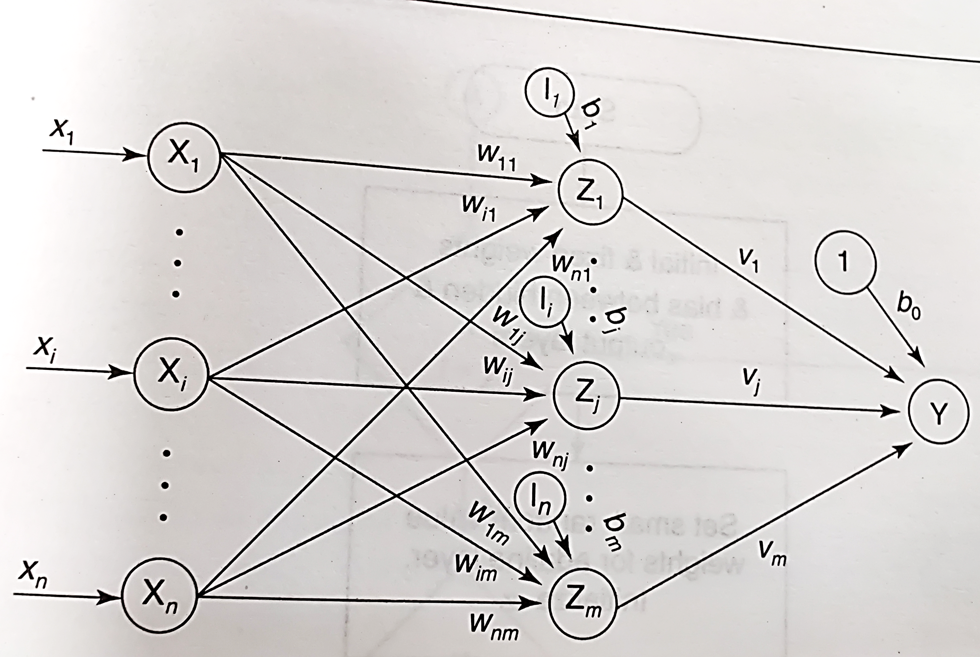
Multiple Adaptive Linear Neuron

Slide 21
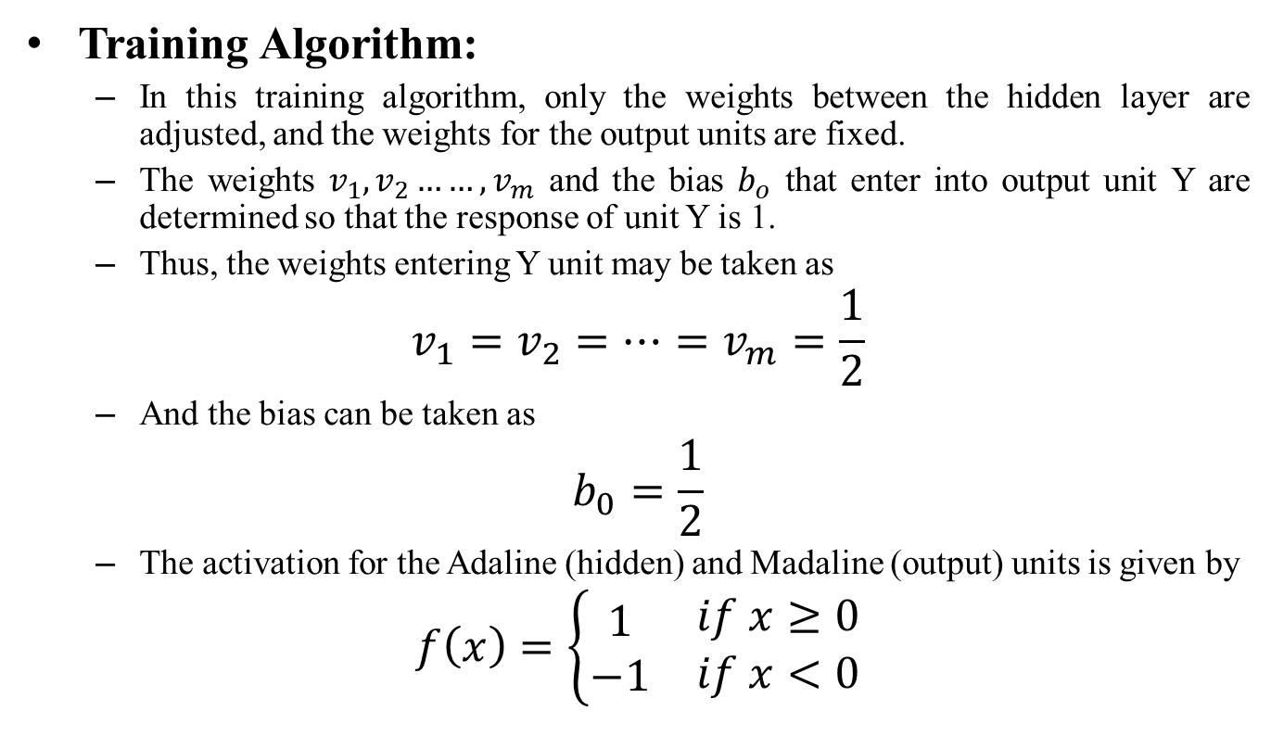
Multiple Adaptive Linear Neuron
Training Algorithm:
In this training algorithm, only the weights between the hidden layer are adjusted, and the weights for the output units are fixed.
The weights $v_{1}, v_{2}……,v_{m}$ and the bias $b_{o}$ that enter into output unit Y are determined so that the response of unit Y is 1.
Thus, the weights entering Y unit may be taken as
$$v_{1}=v_{2}=…=v_{m}=\frac{1}{2}$$
And the bias can be taken as
$$b_{0}=\frac{1}{2}$$
The activation for the Adaline (hidden) and Madaline (output) units is given by
$$f\left(x\right)=\left\{\begin{matrix}\begin{matrix}1 \\ −1\end{matrix} & \begin{matrix}if x≥0 \\ if x<0\end{matrix}\end{matrix}\right.$$

Slide 22
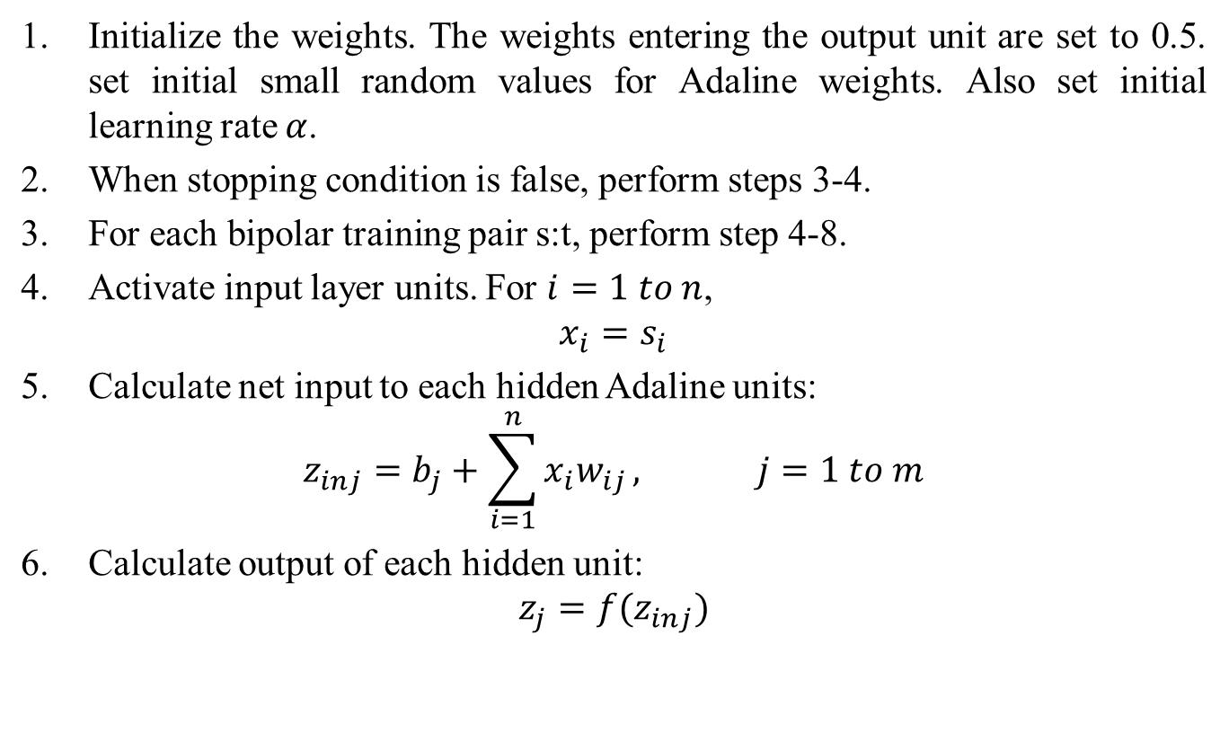
Multiple Adaptive Linear Neuron
Initialize the weights. The weights entering the output unit are set to 0.5. set initial small random values for Adaline weights. Also set initial learning rate $α$.
When stopping condition is false, perform steps 3-4.
For each bipolar training pair s:t, perform step 4-8.
Activate input layer units. For $i=1 to n$,
$$x_{i}=s_{i}$$
Calculate net input to each hidden Adaline units:
$$z_{inj}=b_{j}+\sum_{i=1}^{n}{x_{i}w_{ij}}, j=1 to m$$
Calculate output of each hidden unit:
$$z_{j}=f(z_{inj})$$

Slide 23
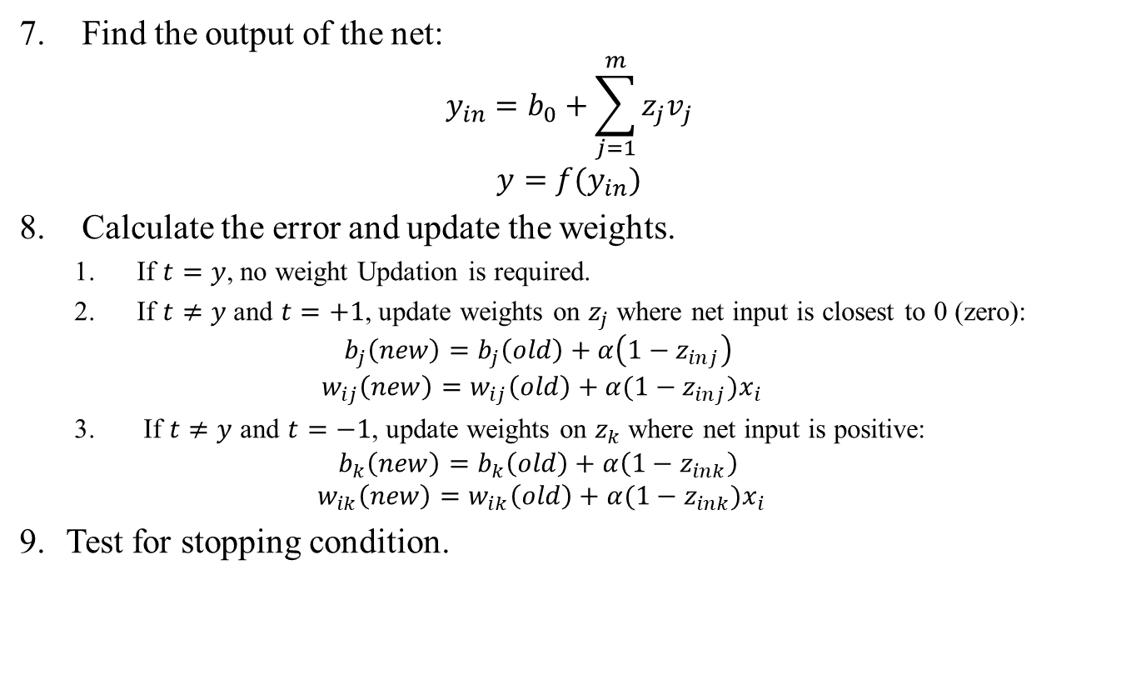
Multiple Adaptive Linear Neuron
Find the output of the net:
$$y_{in}=b_{0}+\sum_{j=1}^{m}{z_{j}v_{j}}$$
$$y=f(y_{in})$$
Calculate the error and update the weights.
If $t=y$, no weight Updation is required.
If $t≠y$ and $t=+1$, update weights on $z_{j}$ where net input is closest to 0 (zero):
$$b_{j}\left(new\right)=b_{j}\left(old\right)+α\left(1−z_{inj}\right)$$
$$w_{ij}\left(new\right)=w_{ij}\left(old\right)+α(1−z_{inj})x_{i}$$
If $t≠y$ and $t=−1$, update weights on $z_{k}$ where net input is positive:
$$b_{k}\left(new\right)=b_{k}\left(old\right)+α\left(1−z_{ink}\right)$$
$$w_{ik}\left(new\right)=w_{ik}\left(old\right)+α(1−z_{ink})x_{i}$$
Test for stopping condition.

Slide 24
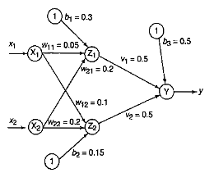
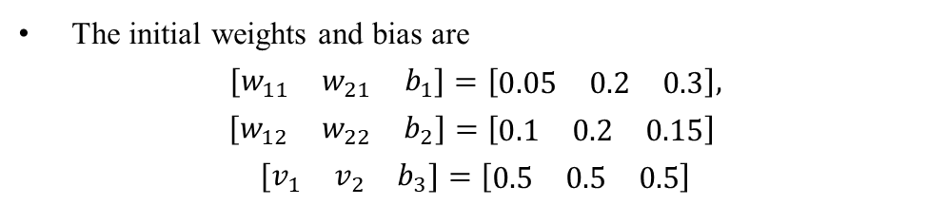
Examples
Example: Using Madaline network, implement XOR function with bipolar inputs and targets. Assume the required parameters for training of the network.
Solution:
The training pattern for XOR function with bipolar inputs and targets is shown in table.
The Madaline algorithm in which the weights between the hidden layer and output layer remain fixed is used for training the network.
Initializing the weights to small random values, the network architecture is shown in figure with initial weights.
x1 | x2 | t
1 | 1 | -1
1 | -1 | 1
-1 | 1 | 1
-1 | -1 | -1
The initial weights and bias are
$$\left[\begin{matrix}w_{11} & w_{21} & b_{1}\end{matrix}\right]=\left[\begin{matrix}0.05 & 0.2 & 0.3\end{matrix}\right],$$
$$\left[\begin{matrix}w_{12} & w_{22} & b_{2}\end{matrix}\right]=\left[\begin{matrix}0.1 & 0.2 & 0.15\end{matrix}\right]$$
$$\left[\begin{matrix}v_{1} & v_{2} & b_{3}\end{matrix}\right]=\left[\begin{matrix}0.5 & 0.5 & 0.5\end{matrix}\right]$$

Slide 25
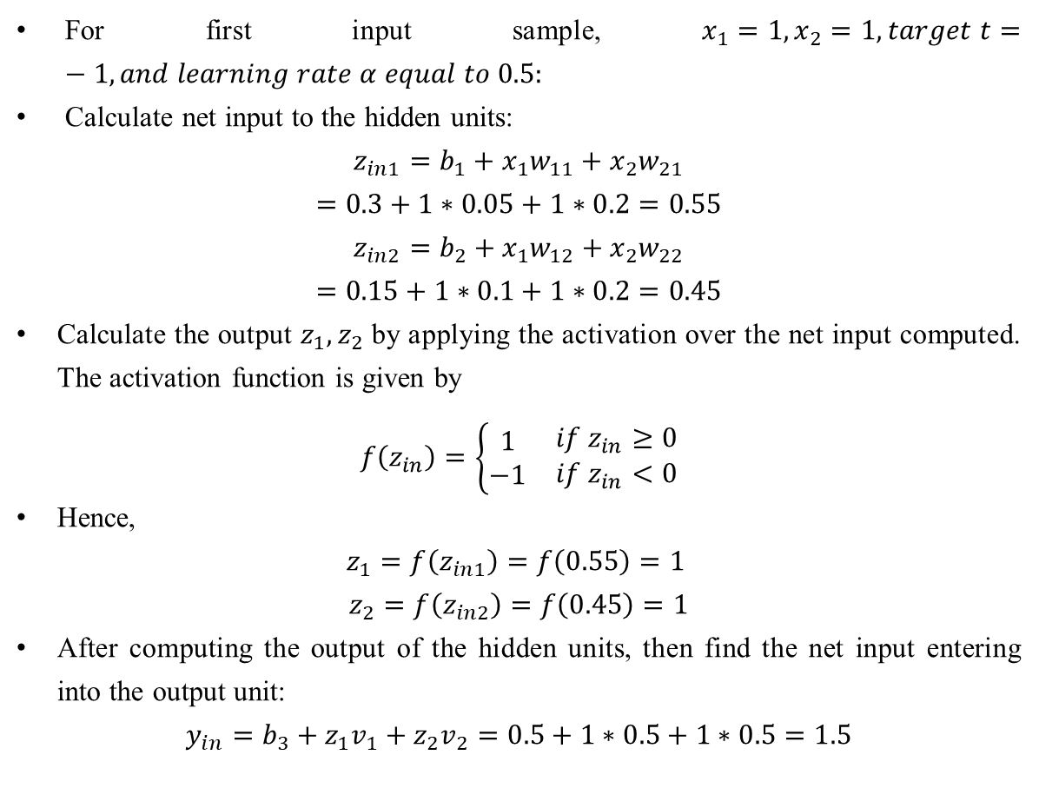
Examples
For first input sample, $x_{1}=1, x_{2}=1, target t=−1, and learning rate α equal to 0.5:$
Calculate net input to the hidden units:
$$z_{in1}=b_{1}+x_{1}w_{11}+x_{2}w_{21}$$
$$=0.3+1∗0.05+1∗0.2=0.55$$
$$z_{in2}=b_{2}+x_{1}w_{12}+x_{2}w_{22}$$
$$=0.15+1∗0.1+1∗0.2=0.45$$
Calculate the output $z_{1}, z_{2}$ by applying the activation over the net input computed. The activation function is given by
$$f\left(z_{in}\right)=\left\{\begin{matrix}\begin{matrix}1 \\ −1\end{matrix} & \begin{matrix}if z_{in}≥0 \\ if z_{in}<0\end{matrix}\end{matrix}\right.$$
Hence,
$$z_{1}=f\left(z_{in1}\right)=f\left(0.55\right)=1$$
$$z_{2}=f\left(z_{in2}\right)=f\left(0.45\right)=1$$
After computing the output of the hidden units, then find the net input entering into the output unit:
$$y_{in}=b_{3}+z_{1}v_{1}+z_{2}v_{2}=0.5+1∗0.5+1∗0.5=1.5$$

Slide 26
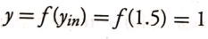
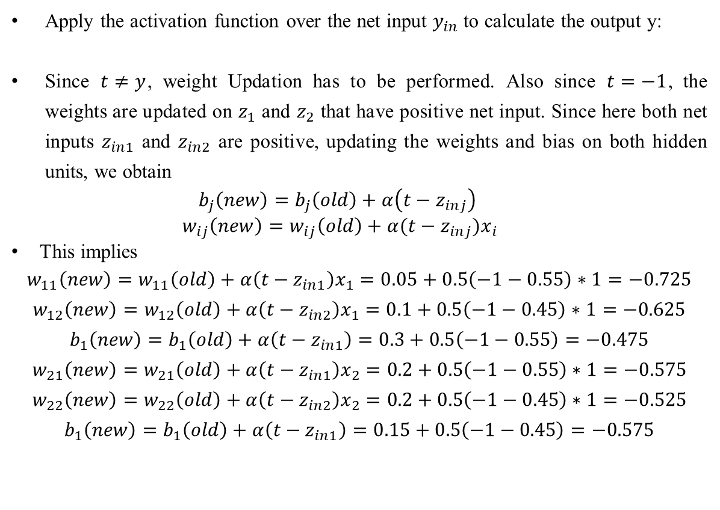
Examples
Apply the activation function over the net input $y_{in}$to calculate the output y:
Since $t≠y$, weight Updation has to be performed. Also since $t=−1$, the weights are updated on $z_{1}$ and $z_{2}$ that have positive net input. Since here both net inputs $z_{in1}$ and $z_{in2}$ are positive, updating the weights and bias on both hidden units, we obtain
$$b_{j}\left(new\right)=b_{j}\left(old\right)+α\left(t−z_{inj}\right)$$
$$w_{ij}\left(new\right)=w_{ij}\left(old\right)+α(t−z_{inj})x_{i}$$
This implies
$$w_{11}\left(new\right)=w_{11}\left(old\right)+α\left(t−z_{in1}\right)x_{1}=0.05+0.5\left(−1−0.55\right)∗1=−0.725$$
$$w_{12}\left(new\right)=w_{12}\left(old\right)+α\left(t−z_{in2}\right)x_{1}=0.1+0.5\left(−1−0.45\right)∗1=−0.625$$
$$b_{1}\left(new\right)=b_{1}\left(old\right)+α\left(t−z_{in1}\right)=0.3+0.5\left(−1−0.55\right)=−0.475$$
$$w_{21}\left(new\right)=w_{21}\left(old\right)+α\left(t−z_{in1}\right)x_{2}=0.2+0.5\left(−1−0.55\right)∗1=−0.575$$
$$w_{22}\left(new\right)=w_{22}\left(old\right)+α\left(t−z_{in2}\right)x_{2}=0.2+0.5\left(−1−0.45\right)∗1=−0.525$$
$$b_{1}\left(new\right)=b_{1}\left(old\right)+α\left(t−z_{in1}\right)=0.15+0.5\left(−1−0.45\right)=−0.575$$

Slide 27
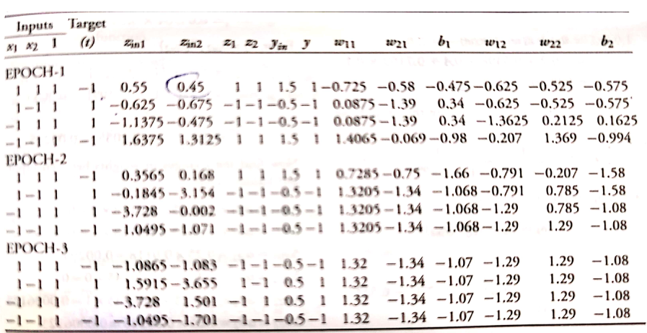
Examples
All the weights and bias between the input layer and hidden layer are adjusted.
This completes the training for the first epoch.
The same process is repeated until the weight converges. It is found that the weight converges at the end of 3 epochs.
Table shows the training performance of Madaline network for XOR

Slide 28
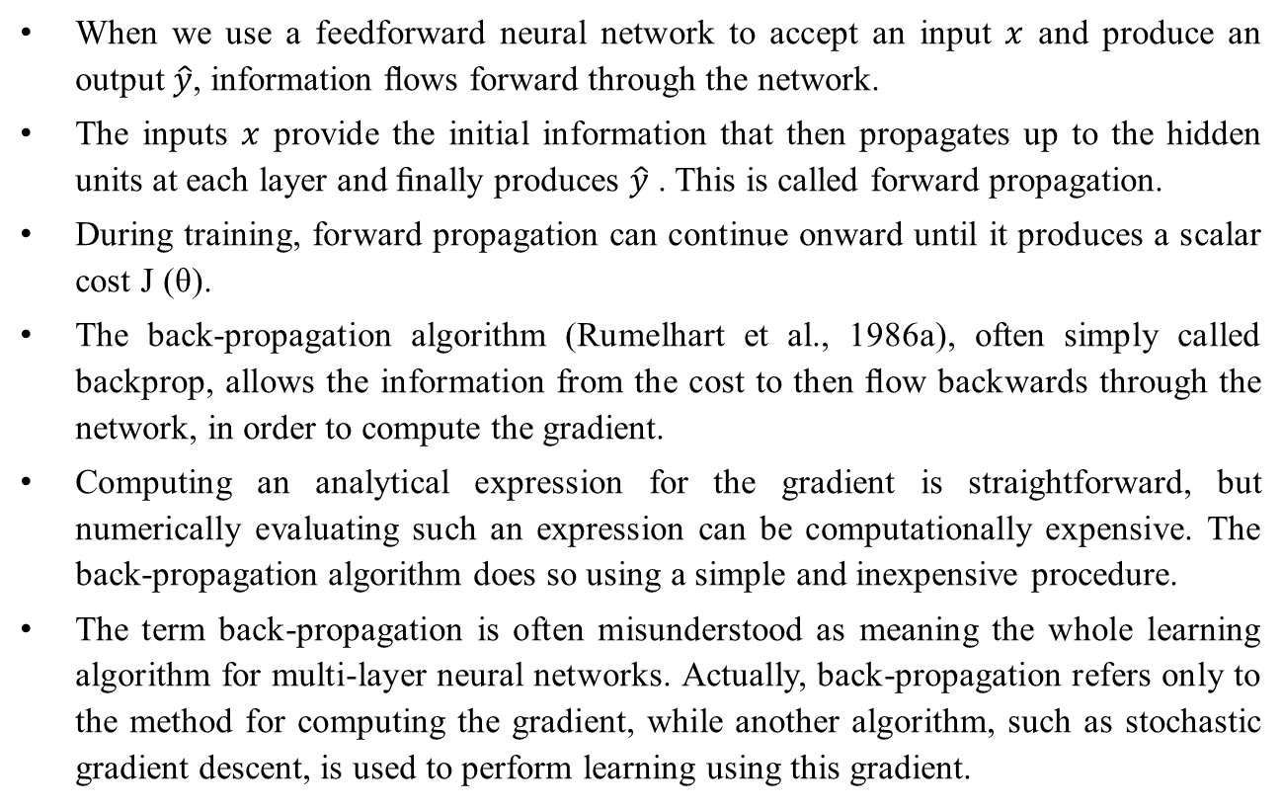
Backpropagation
When we use a feedforward neural network to accept an input $x$ and produce an output $\hat{y}$, information ﬂows forward through the network.
The inputs $x$ provide the initial information that then propagates up to the hidden units at each layer and ﬁnally produces $\hat{y}$ . This is called forward propagation.
During training, forward propagation can continue onward until it produces a scalar cost J (θ).
The back-propagation algorithm (Rumelhart et al., 1986a), often simply called backprop, allows the information from the cost to then ﬂow backwards through the network, in order to compute the gradient.
Computing an analytical expression for the gradient is straightforward, but numerically evaluating such an expression can be computationally expensive. The back-propagation algorithm does so using a simple and inexpensive procedure.
The term back-propagation is often misunderstood as meaning the whole learning algorithm for multi-layer neural networks. Actually, back-propagation refers only to the method for computing the gradient, while another algorithm, such as stochastic gradient descent, is used to perform learning using this gradient.

Slide 29
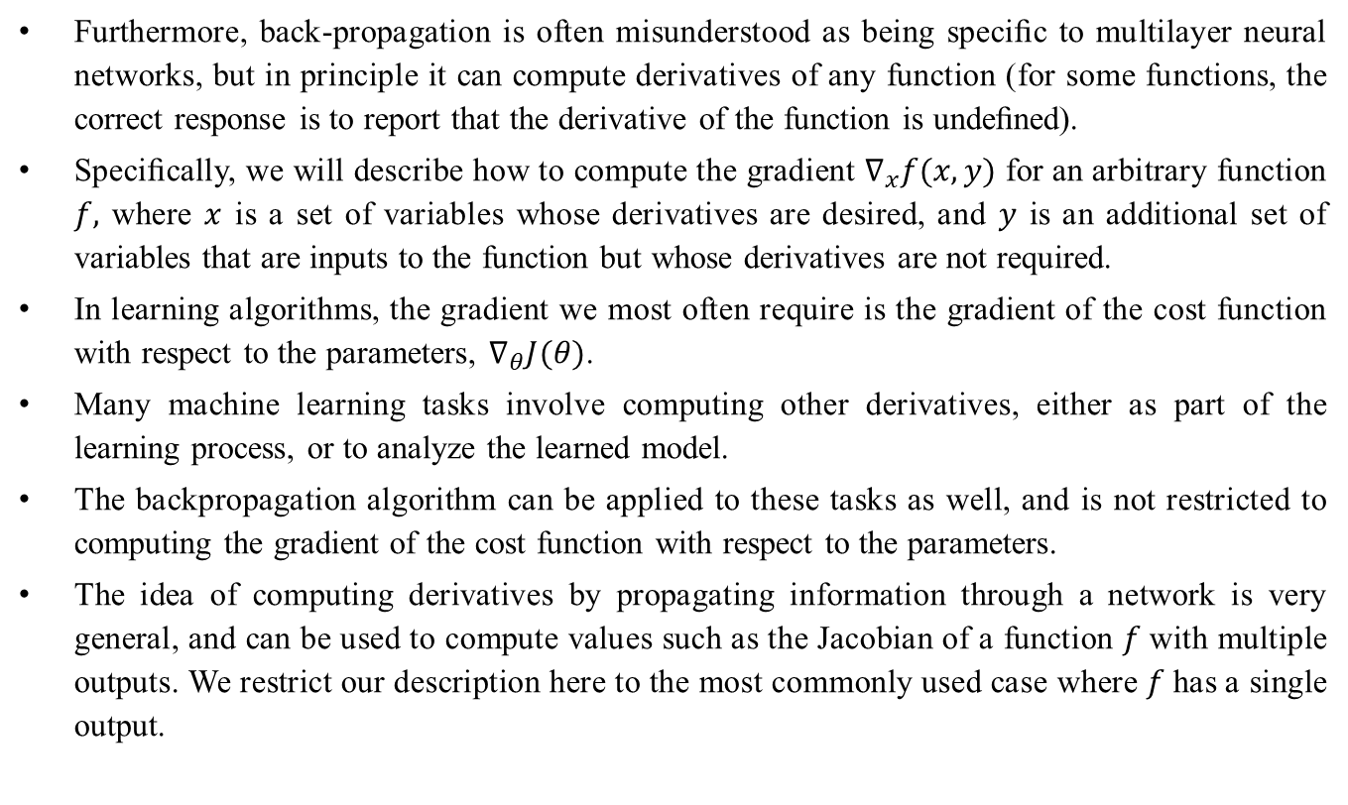
Backpropagation
Furthermore, back-propagation is often misunderstood as being speciﬁc to multilayer neural networks, but in principle it can compute derivatives of any function (for some functions, the correct response is to report that the derivative of the function is undeﬁned).
Speciﬁcally, we will describe how to compute the gradient $∇_{x}f(x, y)$ for an arbitrary function $f,$ where $x$ is a set of variables whose derivatives are desired, and $y$ is an additional set of variables that are inputs to the function but whose derivatives are not required.
In learning algorithms, the gradient we most often require is the gradient of the cost function with respect to the parameters, $∇_{θ}J(θ)$.
Many machine learning tasks involve computing other derivatives, either as part of the learning process, or to analyze the learned model.
The backpropagation algorithm can be applied to these tasks as well, and is not restricted to computing the gradient of the cost function with respect to the parameters.
The idea of computing derivatives by propagating information through a network is very general, and can be used to compute values such as the Jacobian of a function $f$with multiple outputs. We restrict our description here to the most commonly used case where $f$has a single output.

Slide 30
Computational Graph
So far we have discussed neural networks with a relatively informal graph language.
To describe the back-propagation algorithm more precisely, it is helpful to have a more precise computational graph language.
Many ways of formalizing computation as graphs are possible.
Here, we use each node in the graph to indicate a variable. The variable may be a scalar, vector, matrix, tensor, or even a variable of another type.
To formalize our graphs, we also need to introduce the idea of an operation. An operation is a simple function of one or more variables. Our graph language is accompanied by a set of allowable operations. Functions more complicated than the operations in this set may be described by composing many operations together.

Slide 31
Computational Graph
Without loss of generality, we deﬁne an operation to return only a single output variable. This does not lose generality because the output variable can have multiple entries, such as a vector. Software implementations of back-propagation usually support operations with multiple outputs, but we avoid this case in our description because it introduces many extra details that are not important to conceptual understanding.
If a variable y is computed by applying an operation to a variable x, then we draw a directed edge from x to y .
We sometimes annotate the output node with the name of the operation applied, and other times omit this label when the operation is clear from context.

Slide 32
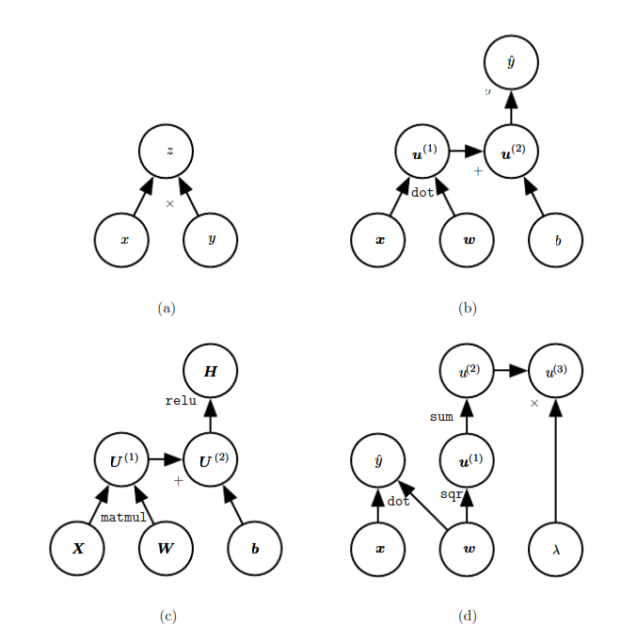
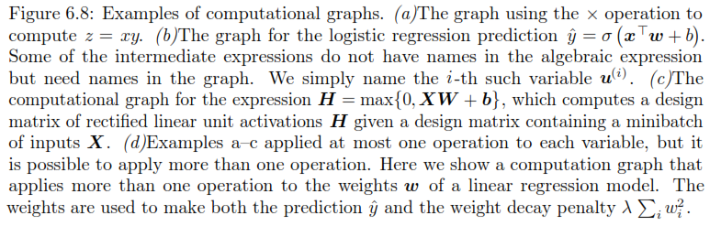
Computational Graph

Slide 33
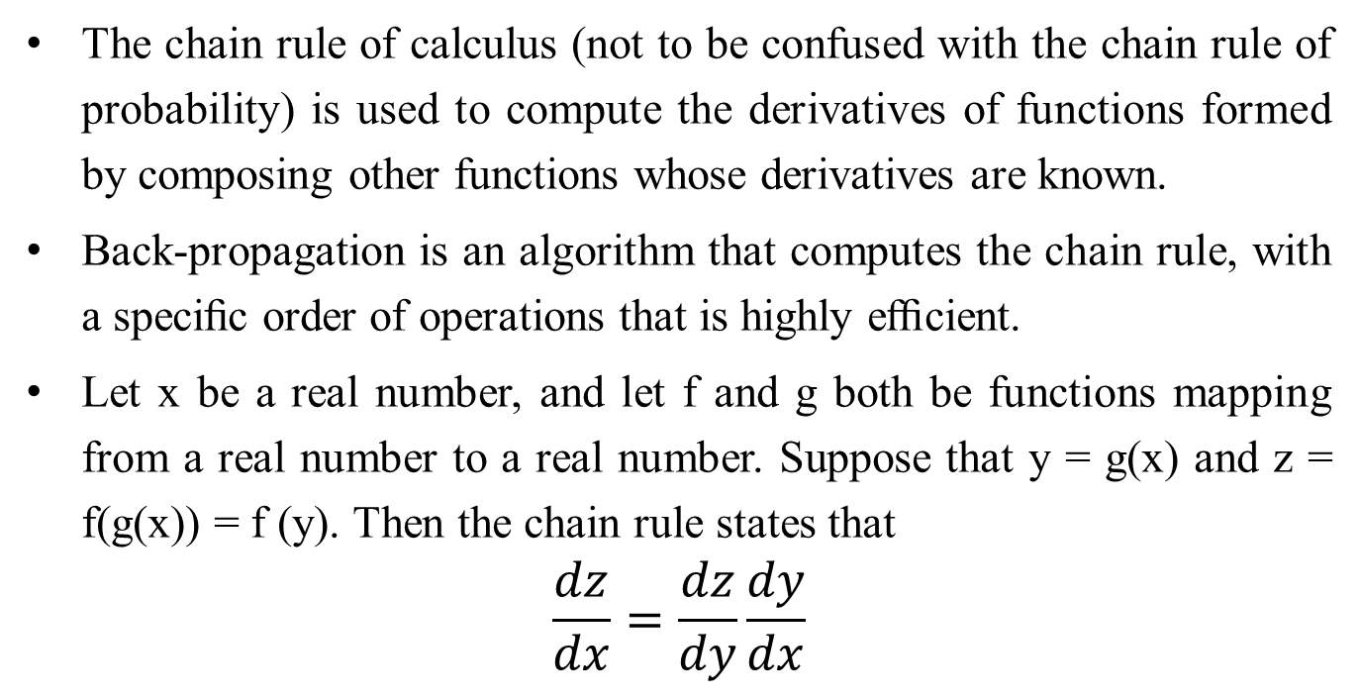
Chain rule of calculus
The chain rule of calculus (not to be confused with the chain rule of probability) is used to compute the derivatives of functions formed by composing other functions whose derivatives are known.
Back-propagation is an algorithm that computes the chain rule, with a speciﬁc order of operations that is highly eﬃcient.
Let x be a real number, and let f and g both be functions mapping from a real number to a real number. Suppose that y = g(x) and z = f(g(x)) = f (y). Then the chain rule states that
$$\frac{dz}{dx}=\frac{dz}{dy}\frac{dy}{dx}$$

Slide 34
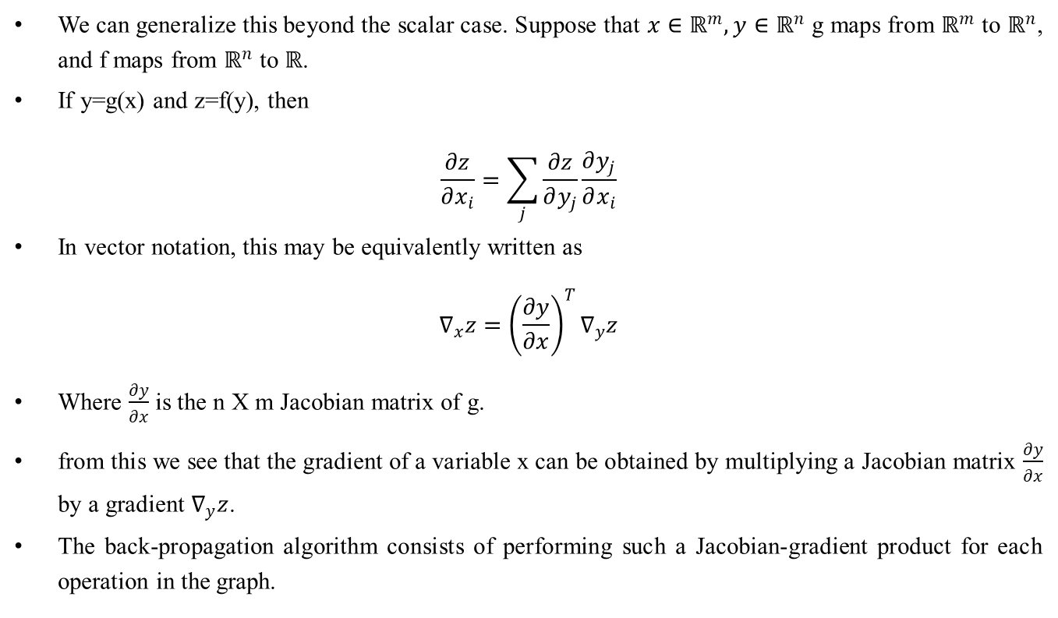
Chain rule of calculus
We can generalize this beyond the scalar case. Suppose that $x∈ℝ^{m}, y∈ℝ^{n}$ g maps from $ℝ^{m}$ to $ℝ^{n}$, and f maps from $ℝ^{n}$ to $ℝ$.
If y=g(x) and z=f(y), then
$$\frac{∂z}{∂x_{i}}=\sum_{j}{\frac{∂z}{∂y_{j}}\frac{∂y_{j}}{∂x_{i}}}$$
In vector notation, this may be equivalently written as
$$∇_{x}z={\left(\frac{∂y}{∂x}\right)}^{T}∇_{y}z$$
Where $\frac{∂y}{∂x}$ is the n X m Jacobian matrix of g.
from this we see that the gradient of a variable x can be obtained by multiplying a Jacobian matrix $\frac{∂y}{∂x}$ by a gradient $∇_{y}z$.
The back-propagation algorithm consists of performing such a Jacobian-gradient product for each operation in the graph.

Slide 35
Backpropagation Network
The backpropagation learning algorithm is one of the most important developments in neural networks (Bryson and Ho, 1969; Werbos, 1974; Lecun, 1985; Parker, 1985; Rumelhart, 1986).
This learning algorithm is applied to multilayer feed-forward network consisting of processing elements with continuous differentiable activation functions.
The networks associated with back-propagation learning algorithm are also called back-propagation networks (BPNs).
For a given set of training input-output pair, this algorithm provides a procedure for changing the weights in a BPN to classify the given input patterns correctly.
The basic concept for this weight update algorithm is simply the gradient-descent method as used in the case of simple perceptron networks with differentiable units.
This is a method where the error is propagated ack to the hidden unit. The aim is to train the net to achieve a balance between the net's ability to respond (memorization) and its ability to give reasonable responses to the input that is similar but not identical to the one that is used in training (generalization).

Slide 36
Backpropagation Network
The back-propagation algorithm is different from other networks in respect to the process by which the weights are calculated during the learning period of the network.
The general difficulty with the multilayer perceptron's is calculating the weights of the hidden layers in an efficient way that would result in a very small or zero output error.
When the hidden layers are increased the network training becomes more complex. To update weights, the error must be calculated. The error, Which is the difference between the actual (calculated) and the desired (target) output, is easily measured at the Output layer.
It should be noted that at the hidden layers, there is no direct information of the error. Therefore, other techniques should be used to calculate an error at the hidden layer, which will cause minimization of the output error, and this is the ultimate goal.
The training of the BPN is done in three stages -the feed-forward of the input training pattern, the calculation and back-propagation of the error, and Updation of weights.
The testing of the BPN involves the computation of feed-forward phase only. There can be more than one hidden layer (more beneficial) but one hidden layer is sufficient.
Even though the training is very slow, once the network is trained it can produce its outputs very rapidly.

Slide 38
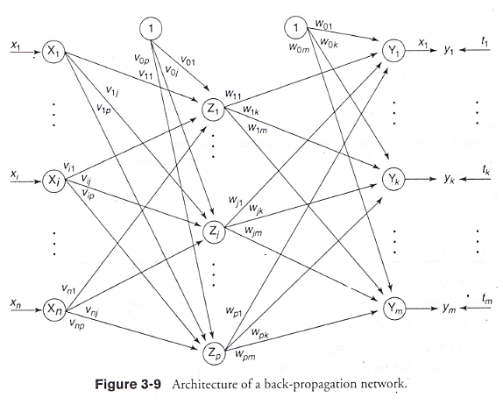
Architecture

Slide 40
Architecture
A back-propagation neural network is a multilayer, feedforward neural network consisting of an input layer, a hidden layer and an output layer.
The neurons present in the hidden and output layers have biases, which are the connections from the units whose activation is always 1.
The bias terms also acts as weights. Figure shows the architecture of a BPN, depicting only the direction of information flow for the feedforward phase.
During the backpropagation phase of learning, signals are sent in the reverse direction.
The inputs are sent to the BPN and the output obtained from the net could be either binary (0, 1) or bipolar (-1, +1).
The activation function could be any function which increases monotonically and is also differentiable.

Slide 41
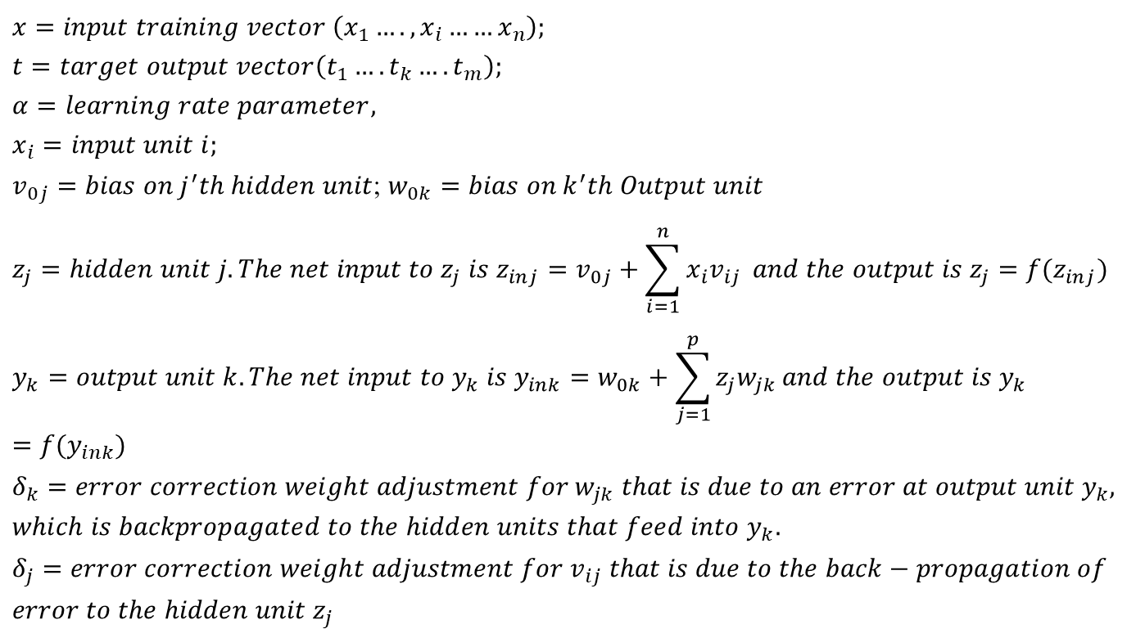
Training Algorithm
$$x=input training vector \left(x_{1}….,x_{i}……x_{n}\right);$$
$$t=target output vector\left(t_{1}….t_{k}….t_{m}\right);$$
$$α=learning rate parameter,$$
$$x_{i}=input unit i;$$
$v_{0j}=bias on j^{′}th hidden unit$; $w_{0k}=bias on k^{′}th Output unit$
$$z_{j}=hidden unit j. The net input to z_{j} is z_{inj}=v_{0j}+\sum_{i=1}^{n}{x_{i}v_{ij}} and the output is z_{j}=f(z_{inj})$$
$$y_{k}=output unit k. The net input to y_{k} is y_{ink}=w_{0k}+\sum_{j=1}^{p}{z_{j}w_{jk}}and the output is y_{k}=f(y_{ink})$$
$$δ_{k}=error correction weight adjustment for w_{jk} that is due to an error at output unit y_{k},$$
$$which is backpropagated to the hidden units that feed into y_{k}.$$
$$δ_{j}=error correction weight adjustment for v_{ij} that is due to the back−propagation of$$
$$error to the hidden unit z_{j}$$

Slide 42
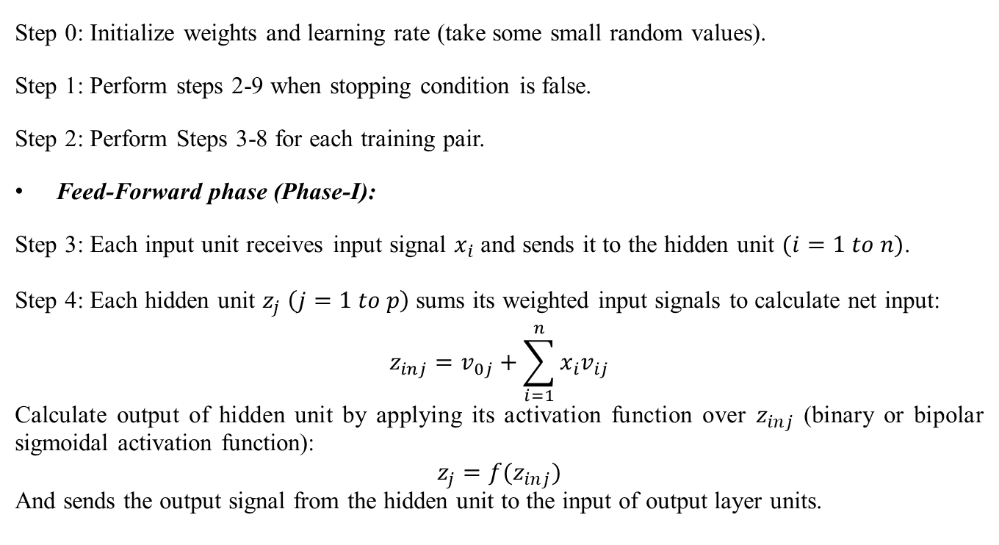
Training Algorithm
Step 0: Initialize weights and learning rate (take some small random values).
Step 1: Perform steps 2-9 when stopping condition is false.
Step 2: Perform Steps 3-8 for each training pair.
Feed-Forward phase (Phase-I):
Step 3: Each input unit receives input signal $x_{i}$ and sends it to the hidden unit $(i=1 to n)$.
Step 4: Each hidden unit $z_{j}$ $\left(j=1 to p\right)$ sums its weighted input signals to calculate net input:
$$z_{inj}=v_{0j}+\sum_{i=1}^{n}{x_{i}v_{ij}}$$
Calculate output of hidden unit by applying its activation function over $z_{inj}$ (binary or bipolar sigmoidal activation function):
$$z_{j}=f(z_{inj})$$
And sends the output signal from the hidden unit to the input of output layer units.

Slide 43
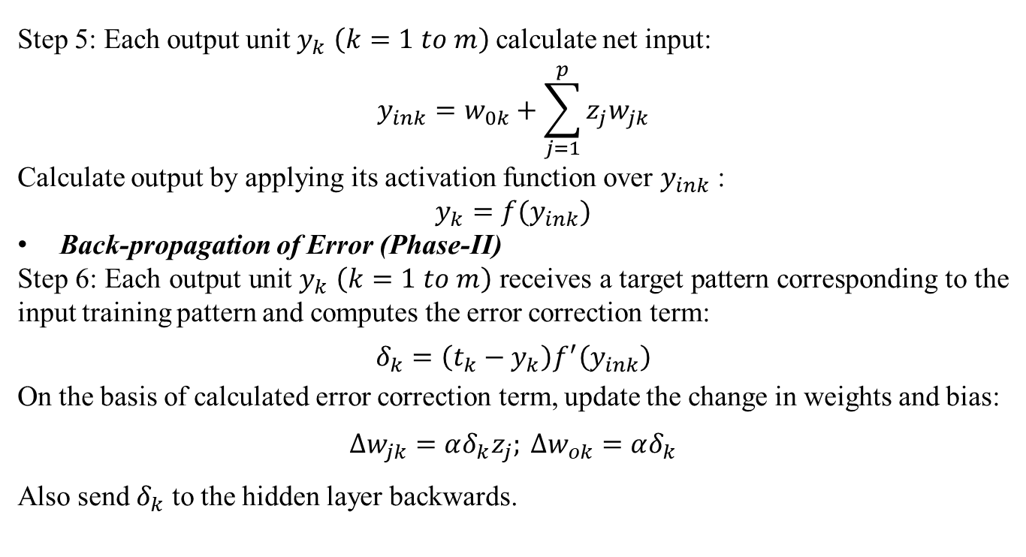
Training Algorithm
Step 5: Each output unit $y_{k}$ $\left(k=1 to m\right)$ calculate net input:
$$y_{ink}=w_{0k}+\sum_{j=1}^{p}{z_{j}w_{jk}}$$
Calculate output by applying its activation function over $y_{ink}$ :
$$y_{k}=f(y_{ink})$$
Back-propagation of Error (Phase-II)
Step 6: Each output unit $y_{k}$ $\left(k=1 to m\right)$ receives a target pattern corresponding to the input training pattern and computes the error correction term:
$$δ_{k}=\left(t_{k}−y_{k}\right)f^{′}\left(y_{ink}\right)$$
On the basis of calculated error correction term, update the change in weights and bias:
$∆w_{jk}=αδ_{k}z_{j}; ∆w_{ok}=αδ_{k}$
Also send $δ_{k}$ to the hidden layer backwards.

Slide 44
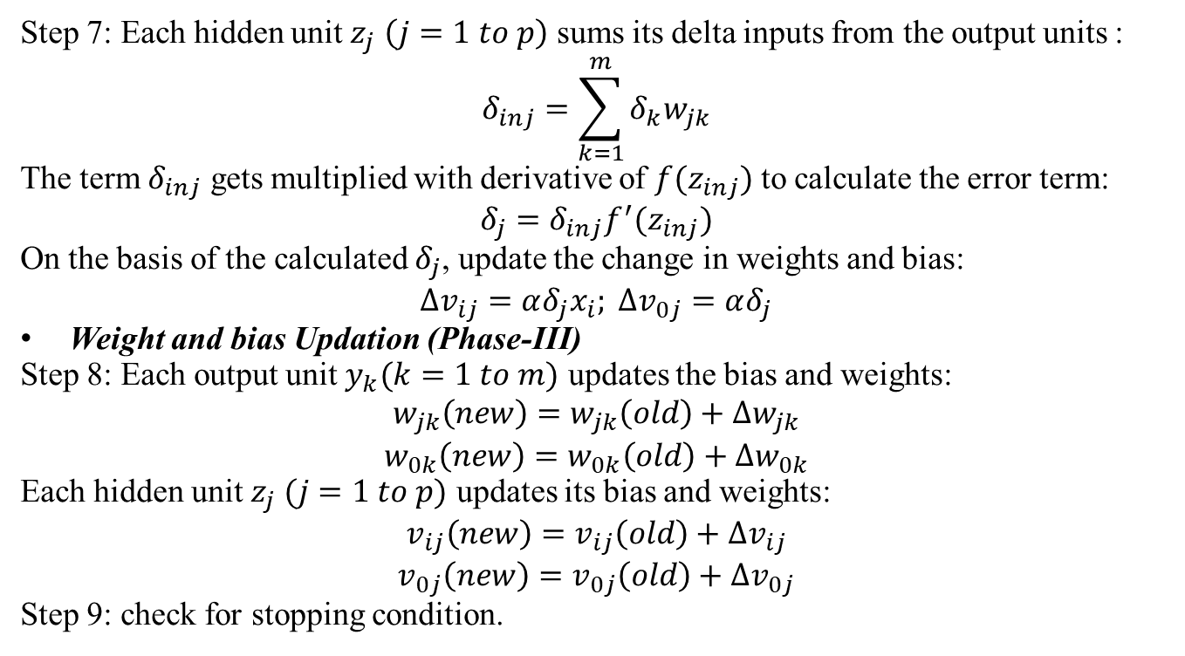
Training Algorithm
Step 7: Each hidden unit $z_{j}$ $\left(j=1 to p\right)$ sums its delta inputs from the output units :
$$δ_{inj}=\sum_{k=1}^{m}{δ_{k}w_{jk}}$$
The term $δ_{inj}$ gets multiplied with derivative of $f(z_{inj})$ to calculate the error term:
$$δ_{j}=δ_{inj}f^{′}(z_{inj})$$
On the basis of the calculated $δ_{j}$, update the change in weights and bias:
$$∆v_{ij}=αδ_{j}x_{i}; ∆v_{0j}=αδ_{j}$$
Weight and bias Updation (Phase-III)
Step 8: Each output unit $y_{k}(k=1 to m)$ updates the bias and weights:
$$w_{jk}\left(new\right)=w_{jk}\left(old\right)+∆w_{jk}$$
$$w_{0k}\left(new\right)=w_{0k}\left(old\right)+∆w_{0k}$$
Each hidden unit $z_{j} (j=1 to p)$ updates its bias and weights:
$$v_{ij}\left(new\right)=v_{ij}\left(old\right)+∆v_{ij}$$
$$v_{0j}\left(new\right)=v_{0j}\left(old\right)+∆v_{0j}$$
Step 9: check for stopping condition.

Slide 45
Backpropagation Network
The above algorithm uses the incremental approach for Updation of weights, i.e., the weights are being changed immediately after a training pattern is presented. There is another way of training called batch-mode training, where the weights are changed only after all the training patterns are presented.
The effectiveness of two approaches depends on the problem, but batch-mode training requires additional local storage for each connection to maintain the immediate weight changes.
When a BPN is used as a classifier, it is equivalent to the optimal Bayesian discriminant function for asymptotically large sets of statistically independent training patterns.
The problem in this case is whether the back-propagation learning algorithm can always converge and find proper weights for network even after enough learning.
It will converge since it implements a gradient-descent on the error surface in the weight space, and this will roll down the error surface to the nearest minimum error and will stop.

Slide 46
Backpropagation Network
This becomes true only when the relation existing between the input and the output training patterns is deterministic and the error surface is deterministic.
This is not the case in real world because the produced square-error surfaces are always at random.
This is the stochastic nature of the back-propagation algorithm, which is purely based on the stochastic gradient-descent method.
The BPN is a special case of stochastic approximation.
If the BPN algorithm converges at all, then it may get stuck with local minima and may be unable to find satisfactory solutions.
The randomness of the algorithm helps it to get out of local minima. The error functions may have large number of global minima because of permutations of weights that keep the network input-output function unchanged. This causes the error surfaces to have numerous troughs.

Slide 47
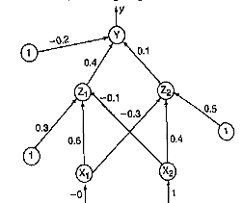
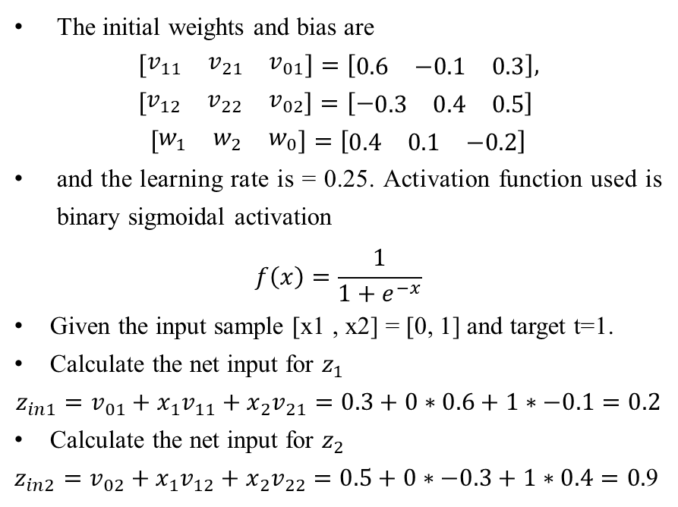
Examples
Example: Using back-propagation network, find the new weights for the net shown in Figure. It is pre­sented with the input pattern [0, 1] and the target output is 1. Use a learning rate = 0.25 and binary sigmoidal activation function.
Solution:
The initial weights and bias are
$$\left[\begin{matrix}v_{11} & v_{21} & v_{01}\end{matrix}\right]=\left[\begin{matrix}0.6 & −0.1 & 0.3\end{matrix}\right],$$
$$\left[\begin{matrix}v_{12} & v_{22} & v_{02}\end{matrix}\right]=\left[−\begin{matrix}0.3 & 0.4 & 0.5\end{matrix}\right]$$
$$\left[\begin{matrix}w_{1} & w_{2} & w_{0}\end{matrix}\right]=\left[\begin{matrix}0.4 & 0.1 & −0.2\end{matrix}\right]$$
and the learning rate is = 0.25. Acti­vation function used is binary sigmoidal activation
$$f\left(x\right)=\frac{1}{1+e^{−x}}$$
Given the input sample [x1 , x2] = [0, 1] and target t=1.
Calculate the net input for $z_{1}$
$$z_{in1}=v_{01}+x_{1}v_{11}+x_{2}v_{21}=0.3+0∗0.6+1∗−0.1=0.2$$
Calculate the net input for $z_{2}$
$z_{in2}=v_{02}+x_{1}v_{12}+x_{2}v_{22}=0.5+0∗−0.3+1∗0.4=0.$9

Slide 48
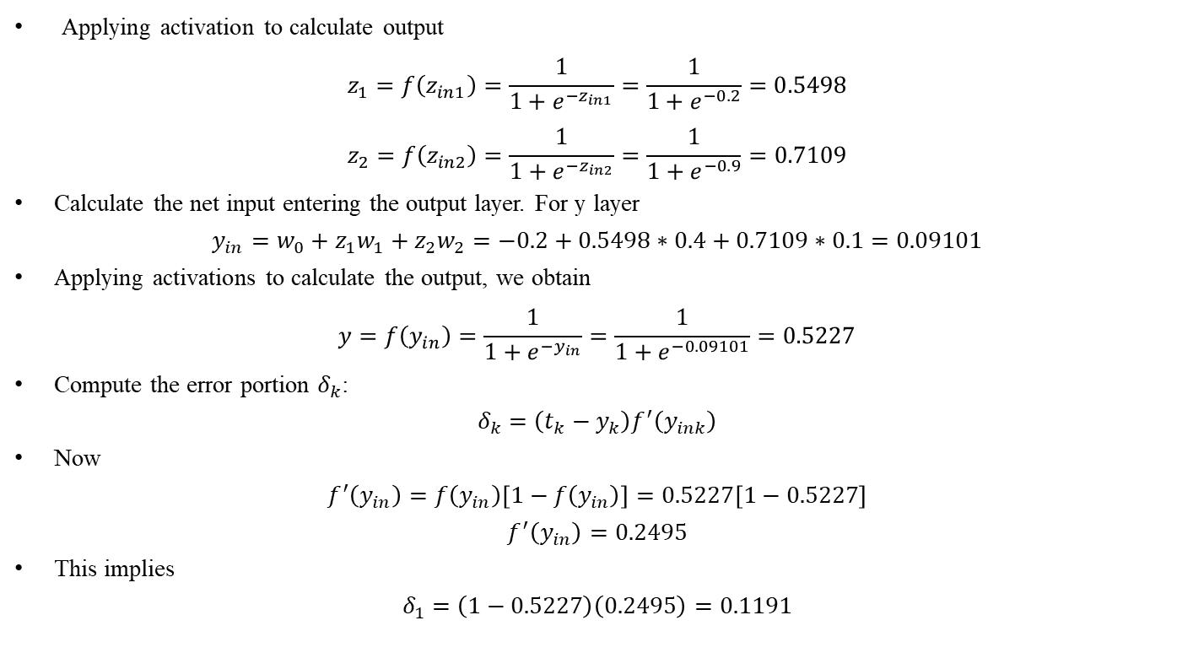
Examples
Applying activation to calculate output
$$z_{1}=f\left(z_{in1}\right)=\frac{1}{1+e^{−z_{in1}}}=\frac{1}{1+e^{−0.2}}=0.5498$$
$$z_{2}=f\left(z_{in2}\right)=\frac{1}{1+e^{−z_{in2}}}=\frac{1}{1+e^{−0.9}}=0.7109$$
Calculate the net input entering the output layer. For y layer
$$y_{in}=w_{0}+z_{1}w_{1}+z_{2}w_{2}=−0.2+0.5498∗0.4+0.7109∗0.1=0.09101$$
Applying activations to calculate the output, we obtain
$$y=f\left(y_{in}\right)=\frac{1}{1+e^{{−y}_{in}}}=\frac{1}{1+e^{−0.09101}}=0.5227$$
Compute the error portion $δ_{k}$:
$$δ_{k}=\left(t_{k}−y_{k}\right)f^{′}\left(y_{ink}\right)$$
Now
$$f^{′}\left(y_{in}\right)=f\left(y_{in}\right)\left[1−f\left(y_{in}\right)\right]=0.5227\left[1−0.5227\right]$$
$$f^{′}\left(y_{in}\right)=0.2495$$
This implies
$$δ_{1}=\left(1−0.5227\right)\left(0.2495\right)=0.1191$$

Slide 49
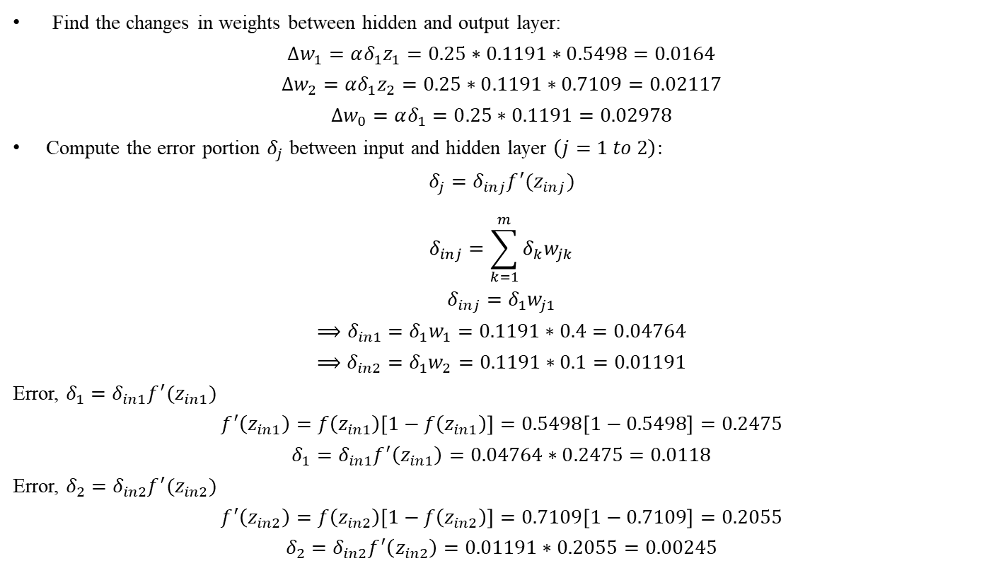
Examples
Find the changes in weights between hidden and output layer:
$$∆w_{1}=αδ_{1}z_{1}=0.25∗0.1191∗0.5498=0.0164$$
$$∆w_{2}=αδ_{1}z_{2}=0.25∗0.1191∗0.7109=0.02117$$
$$∆w_{0}=αδ_{1}=0.25∗0.1191=0.02978$$
Compute the error portion $δ_{j}$ between input and hidden layer $\left(j=1 to 2\right):$
$$δ_{j}=δ_{inj}f^{′}(z_{inj})$$
$$δ_{inj}=\sum_{k=1}^{m}{δ_{k}w_{jk}}$$
$$δ_{inj}=δ_{1}w_{j1}$$
$$⟹δ_{in1}=δ_{1}w_{1}=0.1191∗0.4=0.04764$$
$$⟹δ_{in2}=δ_{1}w_{2}=0.1191∗0.1=0.01191$$
Error, $δ_{1}=δ_{in1}f^{′}(z_{in1})$
$$f^{′}\left(z_{in1}\right)=f\left(z_{in1}\right)\left[1−f\left(z_{in1}\right)\right]=0.5498\left[1−0.5498\right]=0.2475$$
$$δ_{1}=δ_{in1}f^{′}\left(z_{in1}\right)=0.04764∗0.2475=0.0118$$
Error, $δ_{2}=δ_{in2}f^{′}(z_{in2})$
$$f^{′}\left(z_{in2}\right)=f\left(z_{in2}\right)\left[1−f\left(z_{in2}\right)\right]=0.7109\left[1−0.7109\right]=0.2055$$
$$δ_{2}=δ_{in2}f^{′}\left(z_{in2}\right)=0.01191∗0.2055=0.00245$$

Slide 50
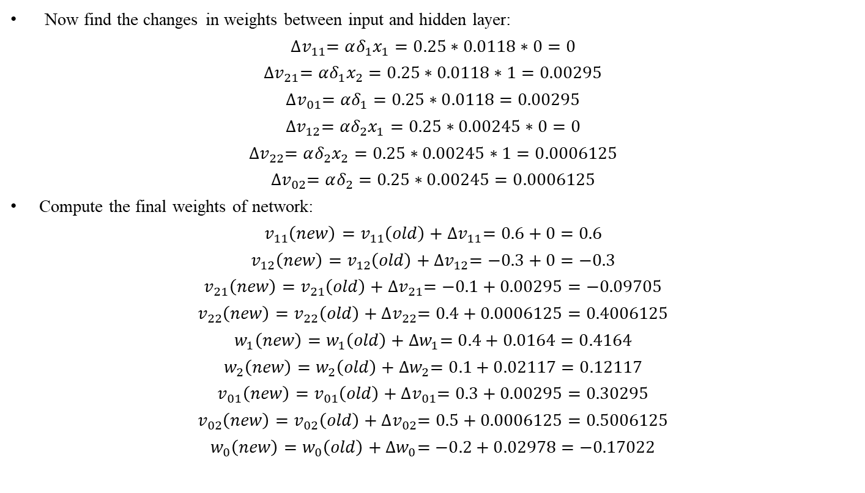
Examples
Now find the changes in weights between input and hidden layer:
$${∆v}_{11}=αδ_{1}x_{1}=0.25∗0.0118∗0=0$$
${∆v}_{21}=αδ_{1}x_{2}=0.25∗0.0118∗1=0.00295$
$${∆v}_{01}=αδ_{1}=0.25∗0.0118=0.00295$$
$${∆v}_{12}=αδ_{2}x_{1}=0.25∗0.00245∗0=0$$
$${∆v}_{22}=αδ_{2}x_{2}=0.25∗0.00245∗1=0.0006125$$
$${∆v}_{02}=αδ_{2}=0.25∗0.00245=0.0006125$$
Compute the final weights of network:
$$v_{11}\left(new\right)=v_{11}\left(old\right)+{∆v}_{11}=0.6+0=0.6$$
$$v_{12}\left(new\right)=v_{12}\left(old\right)+{∆v}_{12}=−0.3+0=−0.3$$
$$v_{21}\left(new\right)=v_{21}\left(old\right)+{∆v}_{21}=−0.1+0.00295=−0.09705$$
$$v_{22}\left(new\right)=v_{22}\left(old\right)+{∆v}_{22}=0.4+0.0006125=0.4006125$$
$$w_{1}\left(new\right)=w_{1}\left(old\right)+{∆w}_{1}=0.4+0.0164=0.4164$$
$$w_{2}\left(new\right)=w_{2}\left(old\right)+{∆w}_{2}=0.1+0.02117=0.12117$$
$$v_{01}\left(new\right)=v_{01}\left(old\right)+{∆v}_{01}=0.3+0.00295=0.30295$$
$$v_{02}\left(new\right)=v_{02}\left(old\right)+{∆v}_{02}=0.5+0.0006125=0.5006125$$
$$w_{0}\left(new\right)=w_{0}\left(old\right)+{∆w}_{0}=−0.2+0.02978=−0.17022$$

Slide 51
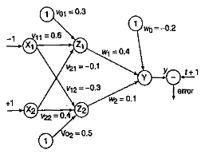
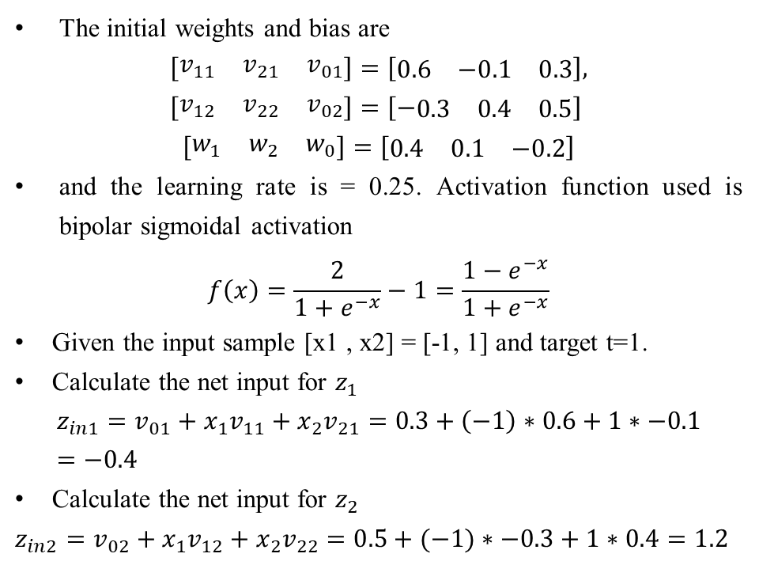
Examples
Example: Using back-propagation network, find the new weights for the net shown in Figure. It is pre­sented with the input pattern [-1, 1] and the target output is 1. Use a learning rate = 0.25 and binary sigmoidal activation function.
Solution:
The initial weights and bias are
$$\left[\begin{matrix}v_{11} & v_{21} & v_{01}\end{matrix}\right]=\left[\begin{matrix}0.6 & −0.1 & 0.3\end{matrix}\right],$$
$$\left[\begin{matrix}v_{12} & v_{22} & v_{02}\end{matrix}\right]=\left[−\begin{matrix}0.3 & 0.4 & 0.5\end{matrix}\right]$$
$$\left[\begin{matrix}w_{1} & w_{2} & w_{0}\end{matrix}\right]=\left[\begin{matrix}0.4 & 0.1 & −0.2\end{matrix}\right]$$
and the learning rate is = 0.25. Acti­vation function used is bipolar sigmoidal activation
$$f\left(x\right)=\frac{2}{1+e^{−x}}−1=\frac{1−e^{−x}}{1+e^{−x}}$$
Given the input sample [x1 , x2] = [-1, 1] and target t=1.
Calculate the net input for $z_{1}$
$$z_{in1}=v_{01}+x_{1}v_{11}+x_{2}v_{21}=0.3+\left(−1\right)∗0.6+1∗−0.1=−0.4$$
Calculate the net input for $z_{2}$
$z_{in2}=v_{02}+x_{1}v_{12}+x_{2}v_{22}=0.5+(−1)∗−0.3+1∗0.4=1.2$

Slide 52
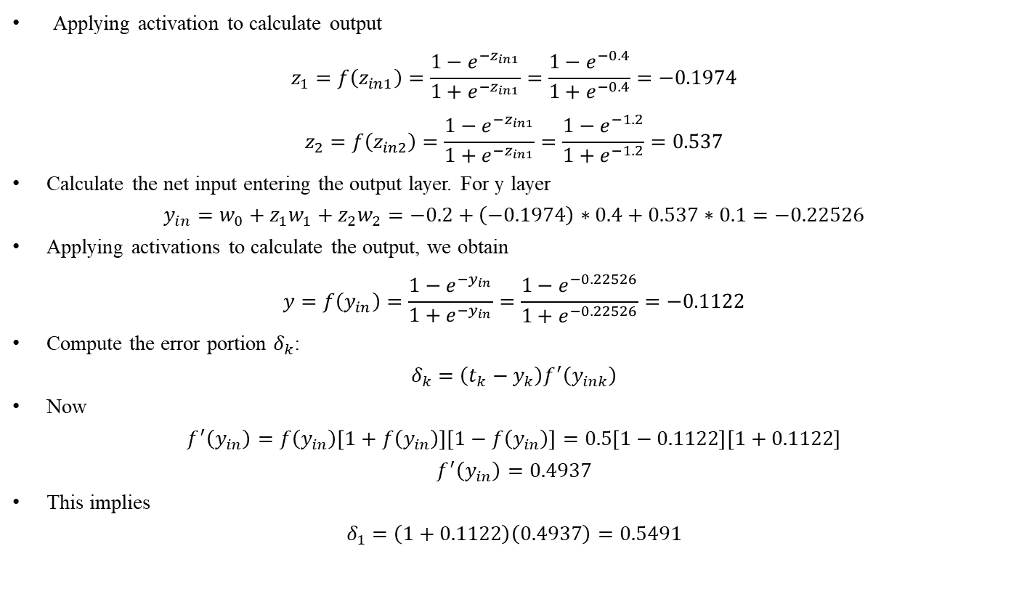
Examples
Applying activation to calculate output
$$z_{1}=f\left(z_{in1}\right)=\frac{1−e^{−z_{in1}}}{1+e^{−z_{in1}}}=\frac{1−e^{−0.4}}{1+e^{−0.4}}=−0.1974$$
$$z_{2}=f\left(z_{in2}\right)=\frac{1−e^{−z_{in1}}}{1+e^{−z_{in1}}}=\frac{1−e^{−1.2}}{1+e^{−1.2}}=0.537$$
Calculate the net input entering the output layer. For y layer
$$y_{in}=w_{0}+z_{1}w_{1}+z_{2}w_{2}=−0.2+\left(−0.1974\right)∗0.4+0.537∗0.1=−0.22526$$
Applying activations to calculate the output, we obtain
$$y=f\left(y_{in}\right)=\frac{1−e^{−y_{in}}}{1+e^{−y_{in}}}=\frac{1−e^{−0.22526}}{1+e^{−0.22526}}=−0.1122$$
Compute the error portion $δ_{k}$:
$$δ_{k}=\left(t_{k}−y_{k}\right)f^{′}\left(y_{ink}\right)$$
Now
$$f^{′}\left(y_{in}\right)=f\left(y_{in}\right)\left[1+f\left(y_{in}\right)\right]\left[1−f\left(y_{in}\right)\right]=0.5\left[1−0.1122\right]\left[1+0.1122\right]$$
$$f^{′}\left(y_{in}\right)=0.4937$$
This implies
$$δ_{1}=\left(1+0.1122\right)\left(0.4937\right)=0.5491$$

Slide 53
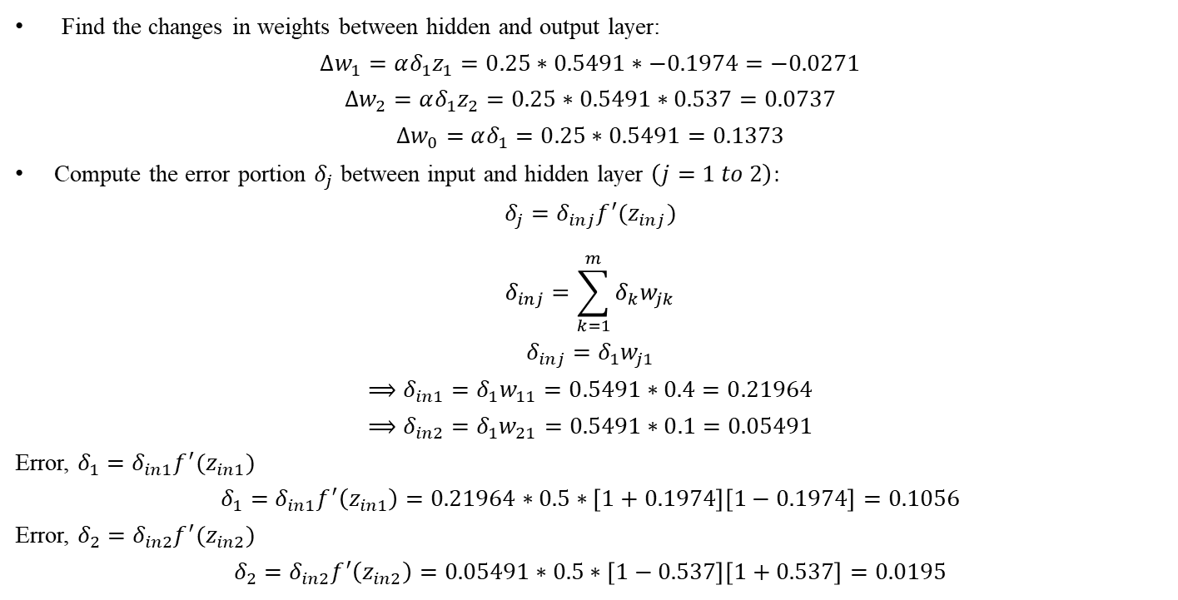
Examples
Find the changes in weights between hidden and output layer:
$$∆w_{1}=αδ_{1}z_{1}=0.25∗0.5491∗−0.1974=−0.0271$$
$$∆w_{2}=αδ_{1}z_{2}=0.25∗0.5491∗0.537=0.0737$$
$$∆w_{0}=αδ_{1}=0.25∗0.5491=0.1373$$
Compute the error portion $δ_{j}$ between input and hidden layer $\left(j=1 to 2\right):$
$$δ_{j}=δ_{inj}f^{′}(z_{inj})$$
$$δ_{inj}=\sum_{k=1}^{m}{δ_{k}w_{jk}}$$
$$δ_{inj}=δ_{1}w_{j1}$$
$$⟹δ_{in1}=δ_{1}w_{11}=0.5491∗0.4=0.21964$$
$$⟹δ_{in2}=δ_{1}w_{21}=0.5491∗0.1=0.05491$$
Error, $δ_{1}=δ_{in1}f^{′}(z_{in1})$
$$δ_{1}=δ_{in1}f^{′}\left(z_{in1}\right)=0.21964∗0.5∗\left[1+0.1974\right]\left[1−0.1974\right]=0.1056$$
Error, $δ_{2}=δ_{in2}f^{′}(z_{in2})$
$$δ_{2}=δ_{in2}f^{′}\left(z_{in2}\right)=0.05491∗0.5∗\left[1−0.537\right]\left[1+0.537\right]=0.0195$$

Slide 54
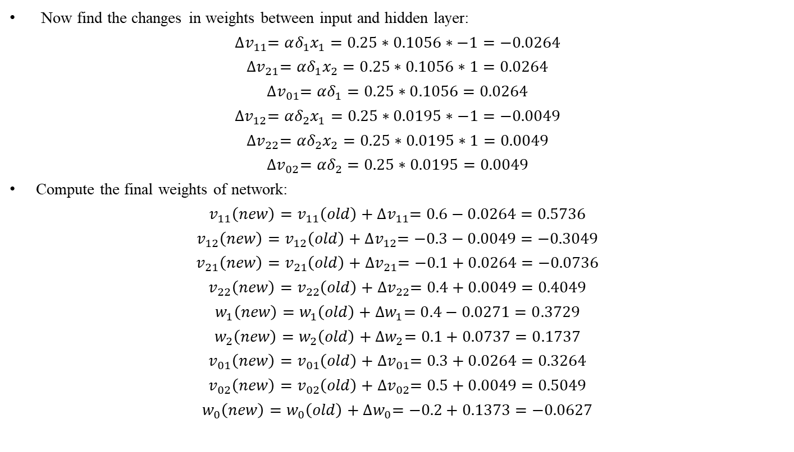
Examples
Now find the changes in weights between input and hidden layer:
$${∆v}_{11}=αδ_{1}x_{1}=0.25∗0.1056∗−1=−0.0264$$
${∆v}_{21}=αδ_{1}x_{2}=0.25∗0.1056∗1=0.0264$
$${∆v}_{01}=αδ_{1}=0.25∗0.1056=0.0264$$
$${∆v}_{12}=αδ_{2}x_{1}=0.25∗0.0195∗−1=−0.0049$$
$${∆v}_{22}=αδ_{2}x_{2}=0.25∗0.0195∗1=0.0049$$
$${∆v}_{02}=αδ_{2}=0.25∗0.0195=0.0049$$
Compute the final weights of network:
$$v_{11}\left(new\right)=v_{11}\left(old\right)+{∆v}_{11}=0.6−0.0264=0.5736$$
$$v_{12}\left(new\right)=v_{12}\left(old\right)+{∆v}_{12}=−0.3−0.0049=−0.3049$$
$$v_{21}\left(new\right)=v_{21}\left(old\right)+{∆v}_{21}=−0.1+0.0264=−0.0736$$
$$v_{22}\left(new\right)=v_{22}\left(old\right)+{∆v}_{22}=0.4+0.0049=0.4049$$
$$w_{1}\left(new\right)=w_{1}\left(old\right)+{∆w}_{1}=0.4−0.0271=0.3729$$
$$w_{2}\left(new\right)=w_{2}\left(old\right)+{∆w}_{2}=0.1+0.0737=0.1737$$
$$v_{01}\left(new\right)=v_{01}\left(old\right)+{∆v}_{01}=0.3+0.0264=0.3264$$
$$v_{02}\left(new\right)=v_{02}\left(old\right)+{∆v}_{02}=0.5+0.0049=0.5049$$
$$w_{0}\left(new\right)=w_{0}\left(old\right)+{∆w}_{0}=−0.2+0.1373=−0.0627$$

Slide 55
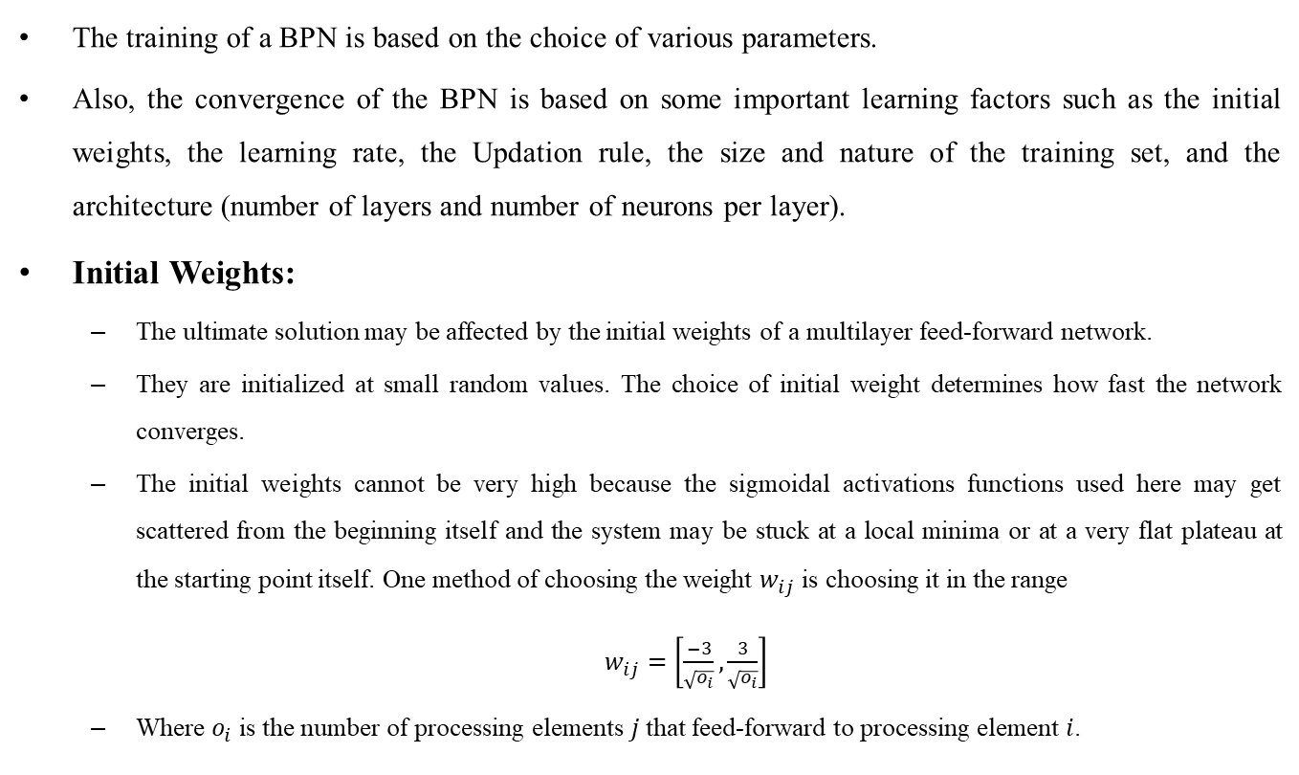
Learning Factors of Back-Propagation Network
The training of a BPN is based on the choice of various parameters.
Also, the convergence of the BPN is based on some important learning factors such as the initial weights, the learning rate, the Updation rule, the size and nature of the training set, and the architecture (number of layers and number of neurons per layer).
Initial Weights:
The ultimate solution may be affected by the initial weights of a multilayer feed-forward network.
They are initialized at small random values. The choice of initial weight determines how fast the network converges.
The initial weights cannot be very high because the sigmoidal activations functions used here may get scattered from the beginning itself and the system may be stuck at a local minima or at a very flat plateau at the starting point itself. One method of choosing the weight $w_{ij}$ is choosing it in the range
$w_{ij}=\left[\frac{−3}{\sqrt{o_{i}}},\frac{3}{\sqrt{o_{i}}}\right]$
Where $o_{i}$ is the number of processing elements $j$ that feed-forward to processing element $i$.

Slide 56
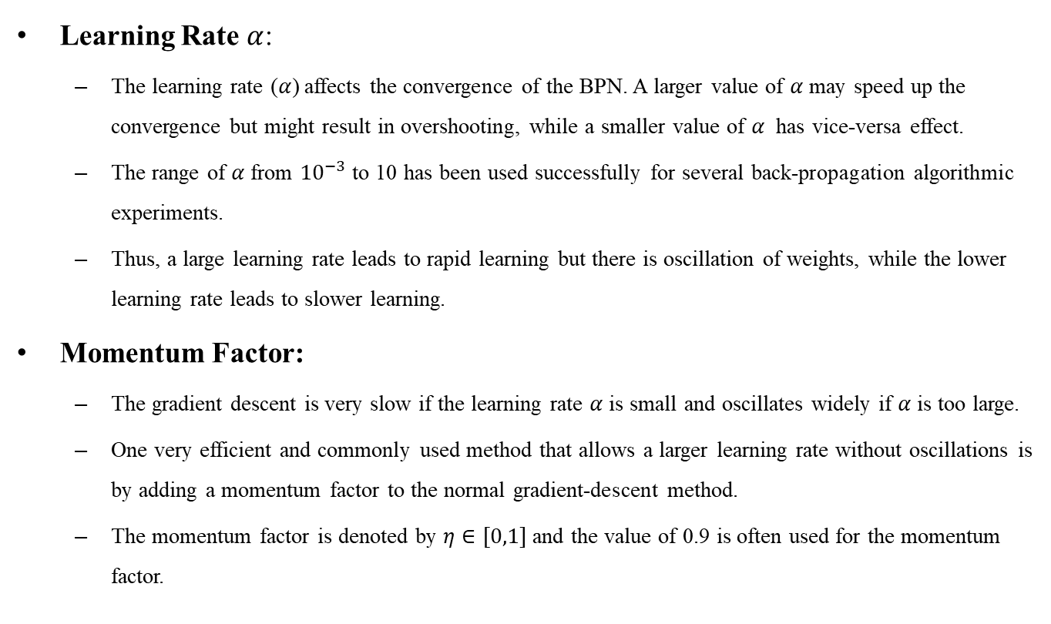
Learning Factors of Back-Propagation Network
Learning Rate $α$:
The learning rate ($α$) affects the convergence of the BPN. A larger value of $α$ may speed up the convergence but might result in overshooting, while a smaller value of $α$ has vice-versa effect.
The range of $α$from ${10}^{−3}$ to 10 has been used successfully for several back-propagation algorithmic experiments.
Thus, a large learning rate leads to rapid learning but there is oscillation of weights, while the lower learning rate leads to slower learning.
Momentum Factor:
The gradient descent is very slow if the learning rate $α$ is small and oscillates widely if $α$ is too large.
One very efficient and commonly used method that allows a larger learning rate without oscillations is by adding a momentum factor to the normal gradient-descent method.
The momentum factor is denoted by $η∈[0,1]$ and the value of 0.9 is often used for the momentum factor.

Slide 58
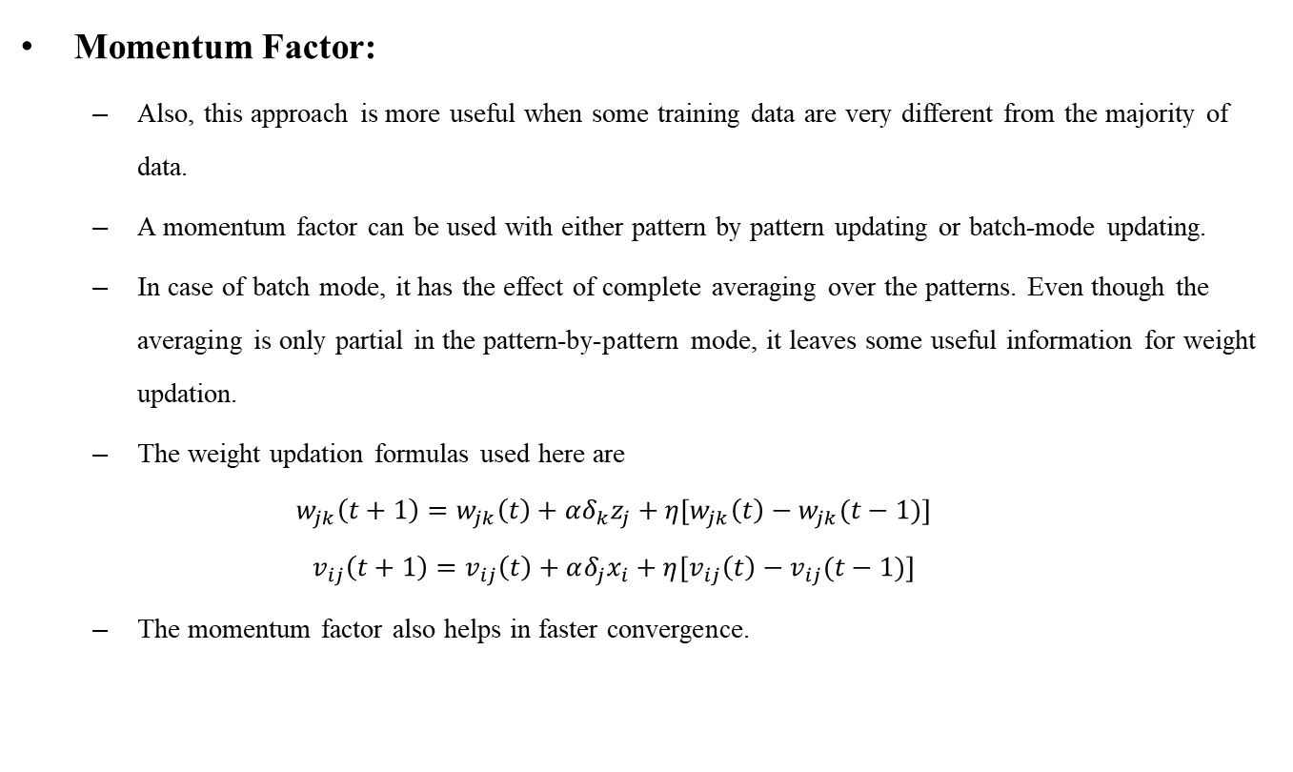
Learning Factors of Back-Propagation Network
Momentum Factor:
Also, this approach is more useful when some training data are very different from the majority of data.
A momentum factor can be used with either pattern by pattern updating or batch-mode updating.
In case of batch mode, it has the effect of complete averaging over the patterns. Even though the averaging is only partial in the pattern-by-pattern mode, it leaves some useful information for weight updation.
The weight updation formulas used here are
$$w_{jk}\left(t+1\right)=w_{jk}\left(t\right)+αδ_{k}z_{j}+η[w_{jk}\left(t\right)−w_{jk}(t−1)]$$
$$v_{ij}\left(t+1\right)=v_{ij}\left(t\right)+αδ_{j}x_{i}+η[v_{ij}\left(t\right)−v_{ij}(t−1)]$$
The momentum factor also helps in faster convergence.

Slide 59
Learning Factors of Back-Propagation Network
Generalization:
The best network for generalization is BPN. A network is said to be generalized when it sensibly interpolates with input networks that are new to the network.
When there are many trainable parameters for the given amount of training data, the network learns well but does not generalize well. This is usually called overfitting or overtraining.
One solution to this problem is to monitor the error on the test set and terminate the training when the error increases.
With small number of trainable parameters, network fails to learn the training data and performs very poorly on the test data.
For improving the ability of the network to generalize from a training data set to a test data set, it is desirable to make small changes in the input space of a pattern, without changing the output components.
This is achieved by introducing variations in the input space of training patterns as part of the training set.
However, computationally, this method is very expensive. Also, a net With large number of nodes is capable of memorizing the training set at the cost of generalization. As a result, smaller nets are preferred than larger ones.

Slide 61
Learning Factors of Back-Propagation Network
Number of Training Data:
The training data should be sufficient and proper. There exists a rule of thumb, which states that the training data should cover the entire expected input space, and while training, training-vector pairs should be selected randomly from the set.
Assume that the input space as being linearly separable into "L" disjoint regions with their boundaries being part of hyper planes.
Let "T" be the lower bound on the number of training patterns. Then, choosing T such that T/L>>1 will allow the network to discriminate pattern classes using fine piecewise hyperplane partitioning.
Also in some cases, scaling or normalization has to be done to help learning.

Slide 62
Learning Factors of Back-Propagation Network
Number of hidden layer nodes:
If there exist more than one hidden layer in BPN, then the calculations performed for a single layer are repeated for all layers and are summed up at the end.
In case of all multilayer feed-forward networks, the size of a hidden layer is very important,
The number of hidden units required for an application needs to be determined separately.
The size of a hidden layer is usually determined experimentally.
For a network of reasonable size, the size of hidden nodes has to be only a relatively small fraction of the input layer.
For example, if the network converges, the user may try a very few hidden nodes and then settle finally on a size based on overall system performance.

